Slide 1

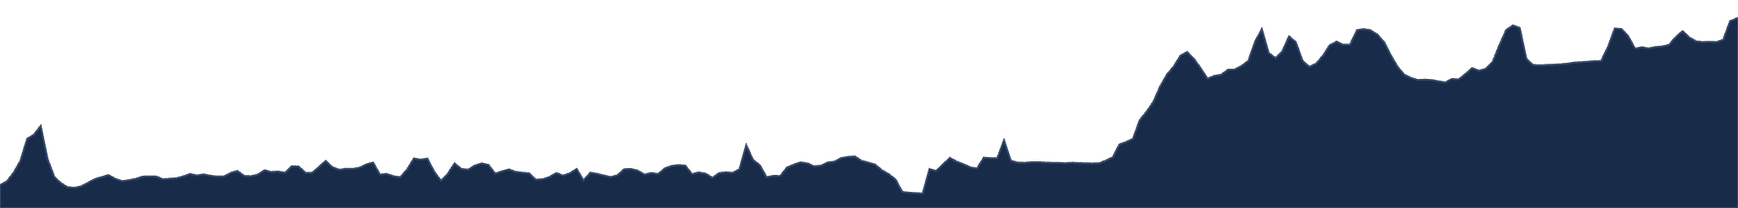








AN UPDATE SINCE THE 8 SEPTEMBER DATA MEETING · 2026-09-23
CALCOFI.IO — WHAT LANDED
SINCE SEPT 8
Every organism and every measurement gets a page · stations, not grid cells · CTD averages by the provider’s rules — and what we decide next.
v2026.09.11
1,008
89
325 M
RELEASE · 23 TABLES · 362 M ROWS
SPECIES · OF 1,506 TAXA · 2,410 PAGES
MEASUREMENTS · 94 SERIES · 5 DATASETS
MEASUREMENT VALUES · 1.3 M ORGANISM OBS.
Ben Best · Ocean Metrics · ben@oceanmetrics.io · data@calcofi.io · DOI 10.5281/zenodo.22714951
Notes:
Thanks for the time. This is the update since the 8 September data meeting — about two weeks of work, two database releases (v2026.09.10 and v2026.09.11, each with its own Zenodo DOI), and one question behind all of it: can someone recognize what is in the database, where it was taken, and whether to trust it? Everything on the slides reads release v2026.09.11 (2026-09-11): 23 tables, 362 M parquet rows, 1,008 species of 1,506 taxa observed (2,410 species pages with their ancestors), 89 measurements in 94 series from 5 datasets, 325 M measurement values counting the full-resolution CTD and underway tables. DOI 10.5281/zenodo.22714951. Screenshots of calcofi.io are from a local build of CalCOFI.github.io main (1e1ffe0, 2026-09-16) reading the same release, light theme; the ctd-transects shots are the app's own static builds at the commits named on those slides. Sources: the release strip and numbers band of calcofi.io; RELEASES.md § v2026.09.10 and § v2026.09.11; workflows commits d0d2d83 and ebe3f66 (the DOIs).

Slide 2






THE ARC OF THIS UPDATE
NAME IT, PLACE IT, TRUST IT — THEN DECIDE
1 · Name
2 · Place
3 · Trust
4 · Next
A page for every organism and every measurement
Stations, not grid cells
The CTD by the provider’s rules
Decide and harmonize
The climatology and the sections key on site_key; the coast comes into focus in ctd-transects.
One colour ramp for sections in both apps; the CTD cast dataset updated; your calls on quotes and scope.
Sensor averages rebuilt from Rasmus’s flag rule; quality codes and the EDI plan agreed.
The Species and Measurements catalogs, each page with a face: what it is, how it is measured, why it matters.
slides 17–20
slides 21–23
slides 24–29
slides 3–16
Two releases since Sept 8 — v2026.09.10 and v2026.09.11, each with its own DOI — and every number on these slides is read from them, never typed.
calcofi.io
CalCOFI.io update · 2026-09-23 · 2
Notes:
The map of the talk, as a story in four stations. 1 Name: the database had 349 M rows and a list of datasets; now every organism and every measurement has its own page with a face — this is most of the new work and where I most want your reactions (slides 3–16, with two slides of explicit questions at 15–16). 2 Place: the climatology and the sections were keyed on the 218 grid cells, which near shore hold several real stations; they now key on the station, and the coast comes into focus (17–20). 3 Trust: the CTD's sensor averages are rebuilt by the rule Rasmus set, and the quality codes and the EDI plan were settled with Rasmus and Marina (21–23). 4 Next: the two to-dos — one colour language for sections across the Explorer and ctd-transects, and the CTD cast dataset update — then decisions and asks with owners (24–29). Two releases landed: v2026.09.10 (DOI 10.5281/zenodo.22698724) and v2026.09.11 (DOI 10.5281/zenodo.22714951).

Slide 3
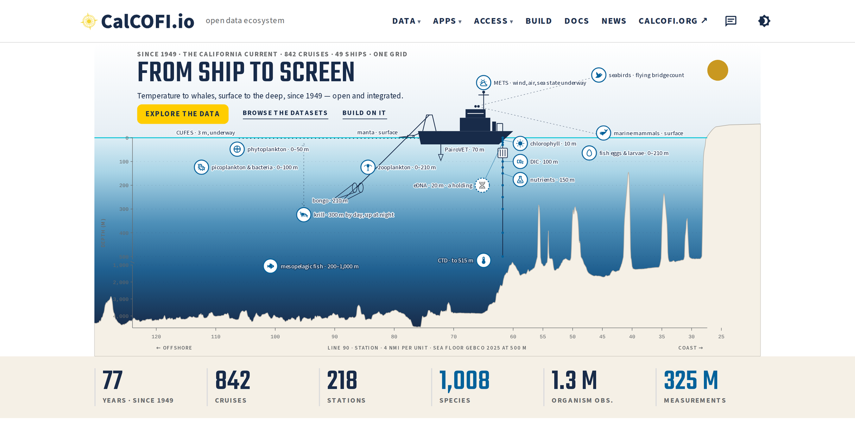
THE FRONT DOOR · CALCOFI.IO
THE FRONT DOOR COUNTS WHAT PEOPLE RECOGNIZE
The band no longer says “349 M rows”: it says 1,008 species, 1.3 M organism observations and 325 M measurements.
Species, not taxa: the common word, kept honest — 1,008 at species rank of 1,506 taxa, keyed to WoRMS (ITIS for birds).
Six words in the header — Data · Apps · Access · Build · Docs · News — and the lockup reads CalCOFI.io on every product.
The ship’s log opens each release at its own heading in RELEASES.html.
calcofi.io — the hero and the numbers band, release v2026.09.11, light theme.
calcofi.io
CalCOFI.io update · 2026-09-23 · 3
Notes:
You asked on 9/9 what the 349 M rows actually are. Measured on v2026.09.06: 316 M were environmental measurements (obs_env plus the two full-resolution tables, 90.7 %), 1.26 M were organism observations (0.36 %), 26 M were the obs compatibility copy counted twice and 4.8 M everything else. So the band now says what people recognize: 77 years · 842 cruises · 218 stations · 1,008 species · 1.3 M organism observations · 325 M measurements (on v2026.09.11), each with a tooltip that carries the breakdown. The release tile keeps rows because it describes the release object. Species, not taxa: 1,008 taxa at species rank, of 1,506 observed; the Life tile says '1,008 species of 1,506 taxa'. The header is six words (Data · Apps · Access · Build · Docs · News) with submenus; Students folded into Apps; the lockup reads CalCOFI.io and product titles are the product's own name (Explorer, Query, Schema, ERDDAP, Docs) across the fleet since 9/11. The release entry in the ship's log links RELEASES.html#v2026.09.11 — 28 of 30 version headings are anchored. Sources: plan 2026-09-09 'Landing follow-ups' § Rows and § Measured (R1, S0, N1, N2); CalCOFI.github.io commits aa1837a, 1de48dd, 3b0c756, 7a6225a, c3d7ea7.

Slide 4

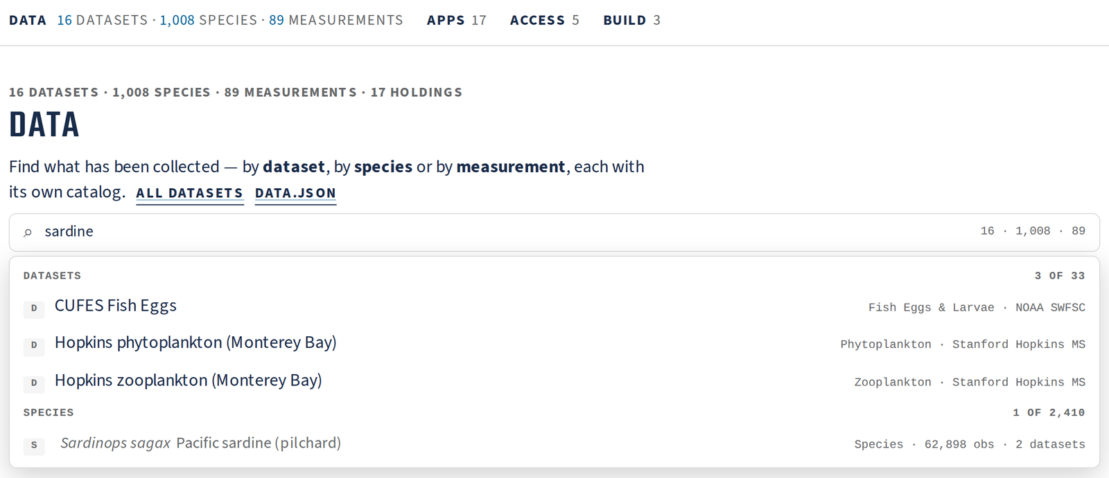
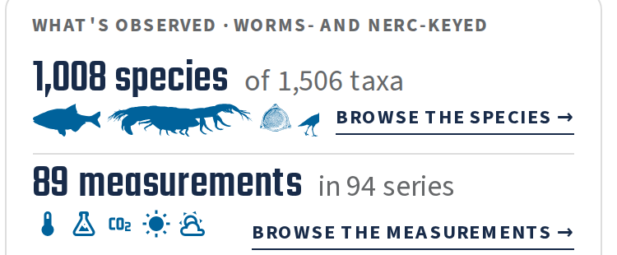
THE FRONT DOOR · DATA
ONE SEARCH BOX OVER THREE CATALOGS
Data is three tabs: Datasets 16 · Species 1,008 · Measurements 89.
One search over all three: “sardine” finds 3 of 33 datasets and 1 of 2,410 species.
calcofi.io → Data, with “sardine” typed: datasets and species as rows you can open.
A licence chip on every dataset row — and 6 of 16 unstated.
calcofi.io/#datasets
CalCOFI.io update · 2026-09-23 · 4
Notes:
The Data section is now three tabs — Datasets (16), Species (1,008) and Measurements (89) — each with its own catalog page, and one search box above them queries all three indexes. Typing 'sardine' lists 3 of the 33 datasets and holdings (CUFES fish eggs, and the two Hopkins Monterey Bay datasets whose descriptions mention sardines) and 1 of 2,410 species (Sardinops sagax, Pacific sardine, 62,898 obs in 2 datasets); a result is a row you can open, and on the Species or Measurements tab the query writes a selectable list into the tab itself. Each dataset row now wears a licence chip of its own look: CC BY 4.0 on 3, CC0 or public domain on 1, provider terms on 6, and unstated on 6 — none says 'custom' any more; that unstated six is the licence gap from last meeting, still open. Homed rows show their variables or taxa behind an expander ('26 variables ▸', '37 taxa ▸'). The What's observed tile (right) links both new catalogs. Sources: plan 2026-09-10 'Measurements catalog' D7; plan 2026-09-15 'faces round 2' WS-R4 (D2, D3, D4, D5) and § Measured; CalCOFI.github.io commits 7a6225a, 00571e3.

Slide 5

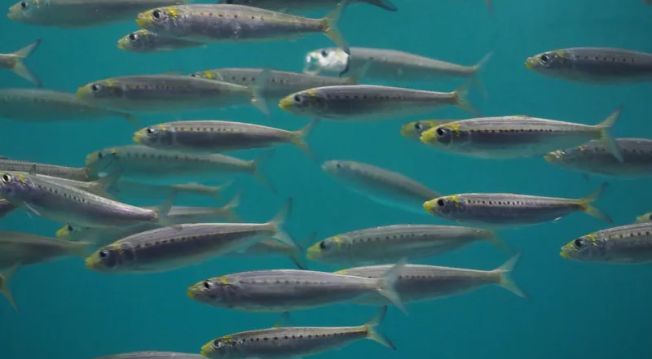
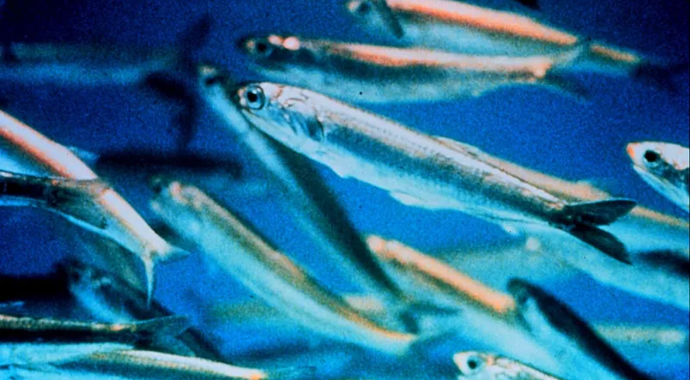
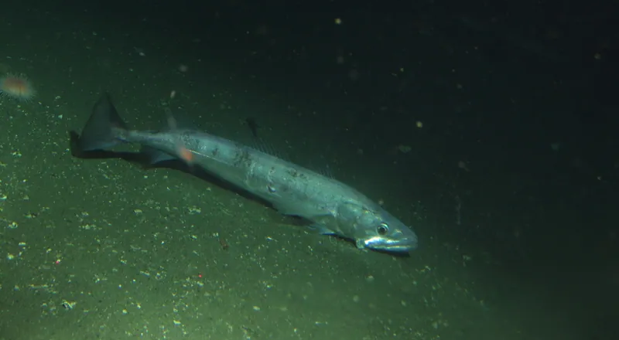
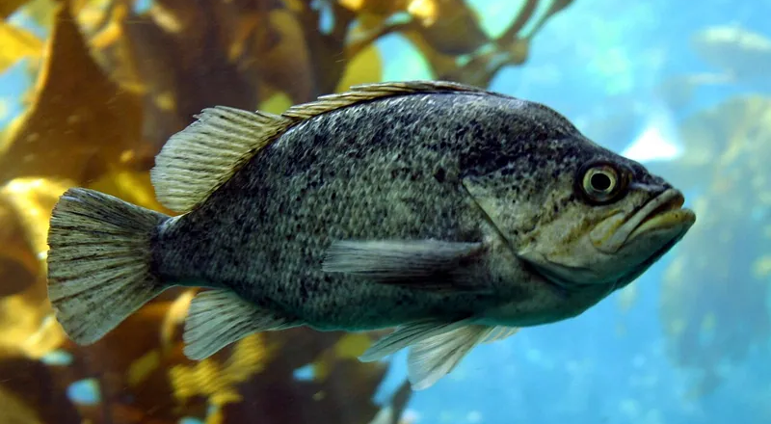
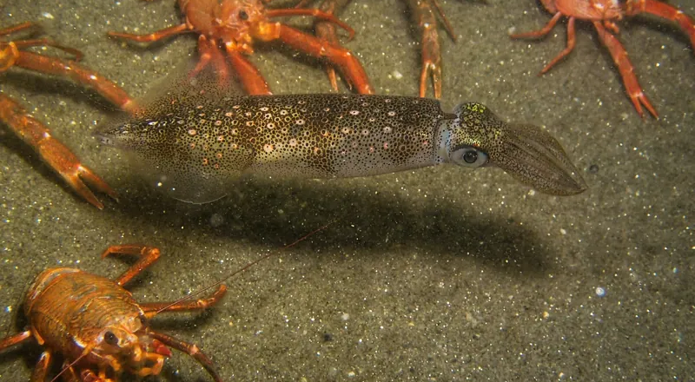
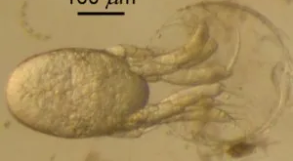
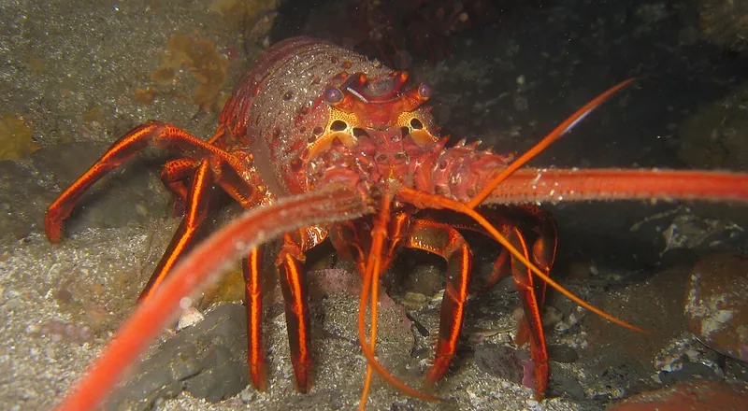
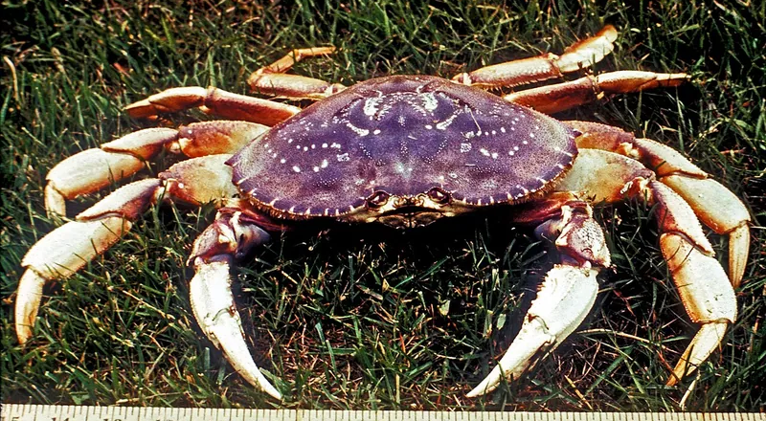
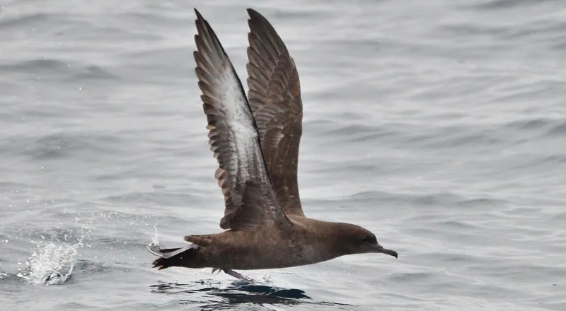
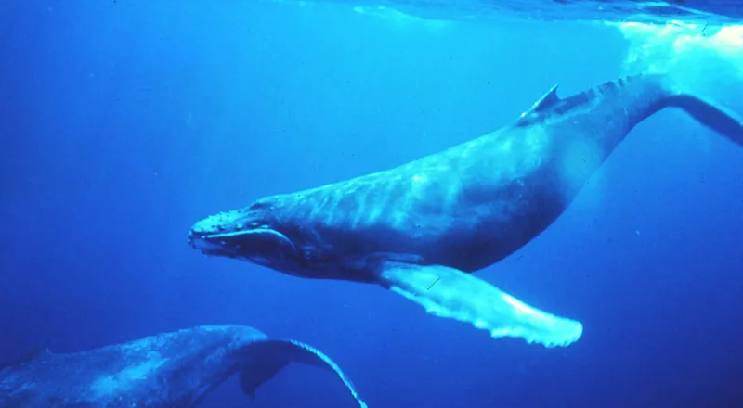
SPECIES · CALCOFI.IO/SPECIES
A PAGE FOR EVERY ORGANISM CALCOFI HAS COUNTED
Pacific sardine
Northern anchovy
Pacific hake
Rockfishes (Sebastes)
Market squid
harum.koh · iNaturalist · CC BY-SA 4.0
NOAA NURP · Commons · public domain
NOAA Photo Library · public domain
Chad King, SIMoN / MBNMS · public domain
Jackie H · iNaturalist · CC BY 4.0
Pacific krill
California spiny lobster
Dungeness crab
Sooty shearwater
Humpback whale
Jaime Gómez-Gutiérrez · Commons · CC BY-SA 3.0
DrKjaergaard (assumed) · CC BY-SA 2.5
Dan Boone · Commons · public domain
Don Loarie · iNaturalist · CC BY 4.0
Louis M. Herman · Commons · public domain
calcofi.io/species/
CalCOFI.io update · 2026-09-23 · 5
Notes:
The species catalog in one picture: ten of its pages, their photos exactly as the pages show them (800 px cached thumbnails on the public bucket, never hot-linked), with the credit and licence each page prints. There are 2,410 pages: the 1,506 taxa observed plus the 904 ancestors that roll them up, so Sebastes rolls up its 30 species and Clupeiformes the sardine, anchovy and herrings; 1,008 are at species rank. The licence policy you agreed on 9/11: take CC0, public domain, CC BY, CC BY-SA; take non-commercial (BY-NC, BY-NC-SA) but rank it last and label it; never ND; never Macaulay, FishBase or WoRMS photos without a written yes. One to look at: the Pacific krill page shows a hatching nauplius (100 µm scale bar) rather than an adult — a real Commons photo of the species, but is a life-stage photo what we want? Credits (from taxa_media.json): sardine, harum.koh (iNat 1339276, CC BY-SA 4.0); anchovy, NOAA/NURP (public domain); hake, NOAA Photo Library (public domain); Sebastes, Chad King SIMoN/MBNMS (public domain); market squid, Jackie H (iNat 78557836, CC BY 4.0); krill, Dr. Jaime Gómez-Gutiérrez (CC BY-SA 3.0); spiny lobster, DrKjaergaard assumed (CC BY-SA 2.5); Dungeness crab, Dan Boone (public domain); sooty shearwater, Don Loarie (iNat 157612, CC BY 4.0); humpback whale, Dr. Louis M. Herman (public domain).

Slide 6
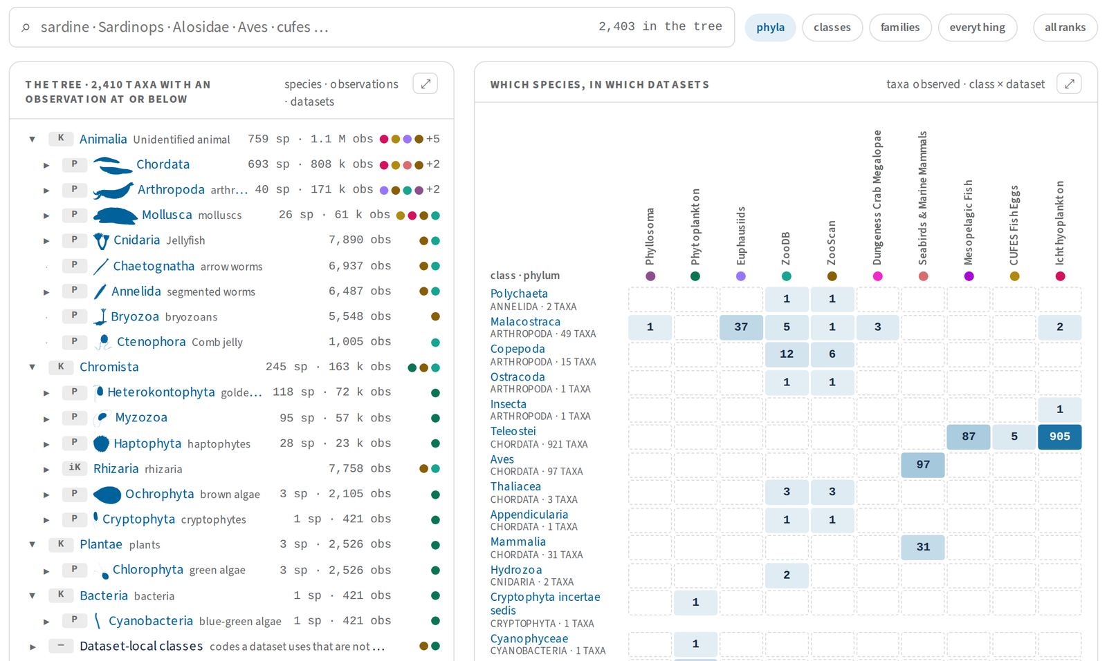
SPECIES · THE OVERVIEW
WALK THE TREE, SEE WHO COUNTED WHAT
2,410 pages: the 1,506 taxa observed plus their 904 ancestors — 1,008 species, 10 datasets, 1,257,902 observations.
The tree, kingdom → species, folded to the major ranks; phylum and class silhouettes; counts and dataset dots on each node.
Which species, in which datasets: a class × dataset matrix — hover for the top three, click to open that class in the tree.
calcofi.io/species/
CalCOFI.io update · 2026-09-23 · 6
Notes:
The /species/ index answers the question you asked on 9/9 — which species are observed in which datasets. The tree (left): kingdom to species, folded by default to the major ranks (kingdom, phylum, class, order, family, genus, species; ?ranks=all shows every WoRMS rank) after your first live review found a species twelve indents deep; either pane expands to the full width; phylum and class silhouettes since 9/11; the two authorities are merged where they name the same rank (birds through ITIS, everything else through WoRMS). The matrix (right, top rows shown): 24 rows — 22 classes by phylum, plus 'identified above class' and dataset-local classes — × 10 datasets, one sequential ramp, the count in each cell; hover names the top three taxa, click filters the tree; dataset colour is never the only cue. Head numbers: 1,008 species · 1,506 taxa observed · 10 datasets · 1,257,902 observations · 2,410 pages. Sources: plan 2026-09-09 'Landing follow-ups' D5, D6, D8 and § Measured (S2, S3, the tree follow-up); CalCOFI.github.io 086801e, 44e3235, 9de15ea.

Slide 7
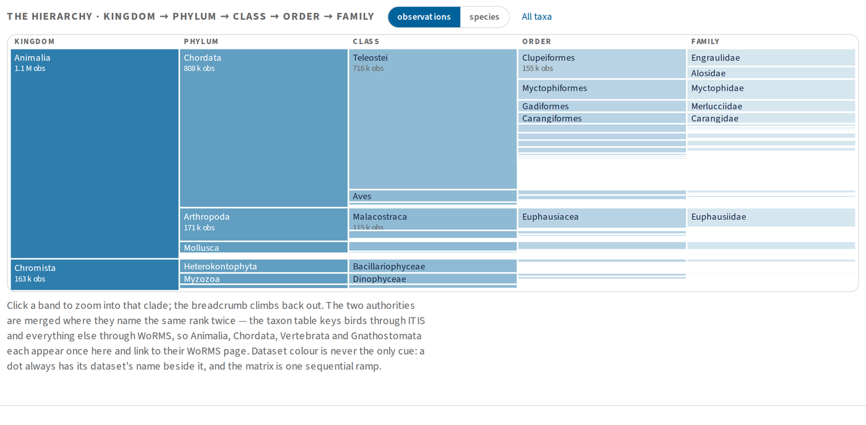
SPECIES · THE OVERVIEW, CONTINUED
THE HIERARCHY, AND A LIST OF MATCHES
/species/?q=sardin → the Matches list.
The hierarchy: click a band to zoom into a clade; a breadcrumb climbs back out.
Matches (round 2): a query fills a flat list above the tree — most observed first — instead of only unfolding 2,410 nodes.
Every page is also data: schema.org Taxon JSON-LD, a {slug}.json and its own sitemap (2,411 URLs).
The hierarchy: kingdom → phylum → class → order → family, sized by observations (or by species).
calcofi.io/species/?q=sardin
CalCOFI.io update · 2026-09-23 · 7
Notes:
Two more parts of the species index. The hierarchy: a horizontal partition — kingdom, phylum, class, order, family — sized by observations (the default) or by species, click a band to zoom into a clade and a breadcrumb to climb out; it shows at a glance that Chordata dominates the observations and that diatoms and dinoflagellates come from one dataset. Search: it matches scientific and common names and dataset names as you type, with ?q= in the URL; round 2 (your 9/15 review) added a flat Matches list above the tree — up to 50 rows, sorted by observations, in the same row shape as the front door's results — because in a 2,410-taxon tree it was not discernible which rows were the matches. Machine-readable: each of the 2,410 pages carries schema.org Taxon JSON-LD (checked by check_jsonld.py), has a {slug}.json twin, and /species/sitemap.xml lists 2,411 URLs; the root sitemap is per catalog. Candidate to drop if the pages feel heavy: the icicle — see slide 16. Sources: plan 2026-09-09 'Landing follow-ups' D8.3 and § Measured S2, S3; plan 2026-09-15 finding I2 and WS-R5.

Slide 8
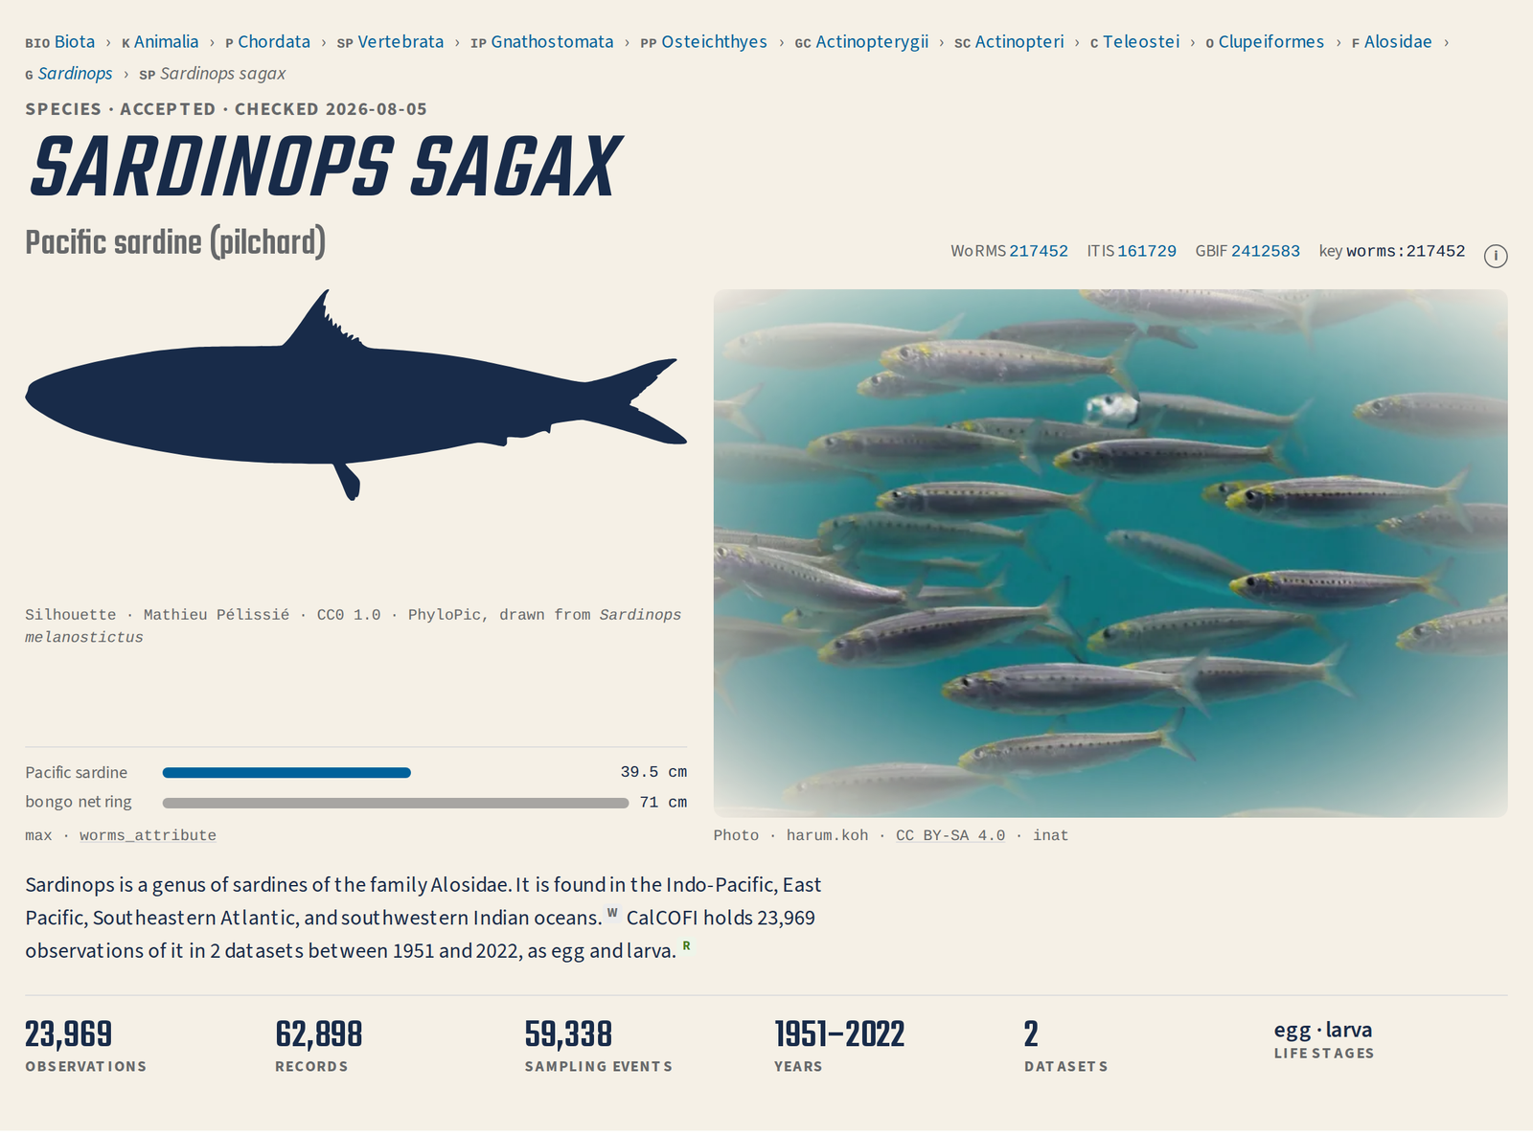
SPECIES · ONE PAGE
EVERY SPECIES PAGE NOW HAS A FACE
Silhouette on every page (PhyloPic, in the page’s ink): 2,396 of 2,410, noted when drawn from a relative.
Photo where the licence allows: 2,082 pages (86 %) from iNaturalist, Commons and GBIF — cached and credited.
Size glance: its maximum length beside the nearest familiar thing — here the bongo net ring; 718 taxa have a length.
The sentence: Wikipedia’s lead + CalCOFI’s own numbers, each part badged W or R.
Observations (non-zero) beside records: 23,969 of 62,898 for the sardine.
calcofi.io/species/worms-217452/
CalCOFI.io update · 2026-09-23 · 8
Notes:
Your ask on 9/11: the species pages were dry. Every page now has a face: the constant is the PhyloPic silhouette in the page's ink (2,396 of 2,410 pages, 99.4 %; the 14 misses are nameless taxa; 381 stand in from more than two ranks up and say so, as here: drawn from Sardinops melanostictus); the enrichment is a licensed photo in one frame with one radial fade, full colour (2,082 pages, 86.4 %: iNaturalist 1,455, Commons 403, GBIF 224; licences CC BY-NC 4.0 732, CC BY 4.0 623, public domain 334, CC BY-SA 114, NC-SA 90). The size glance puts the taxon's maximum length beside the nearest familiar reference (718 taxa, 29.8 %, lengths from FishBase / SeaLifeBase / WoRMS). The sentence borrows Wikipedia's lead (CC BY-SA, linked to the revision; text on 1,566 pages) and adds the record's own sentence; since round 2 each part carries a small source badge (W, R) instead of coloured underlines and a legend. Observations beside records: n_present (value > 0) vs n_obs (rows), because CUFES, phytoplankton, phyllosoma, crab and ZooDB carry zero counts — sardine 23,969 observations of 62,898 records. A 30-page hand review found five photos that were not the organism (an Alcatraz building for the western gull …) and one wrong silhouette (a water mite for Leach's storm petrel); causes fixed, six overrides in rank_override.csv. Coverage numbers are from the 2026-09-11 media run on v2026.09.10. Sources: plan 2026-09-11 'Species faces' D1–D9 and § Measured (F3, F6, LIVE); RELEASES.md § taxa.json 1.1.

Slide 9

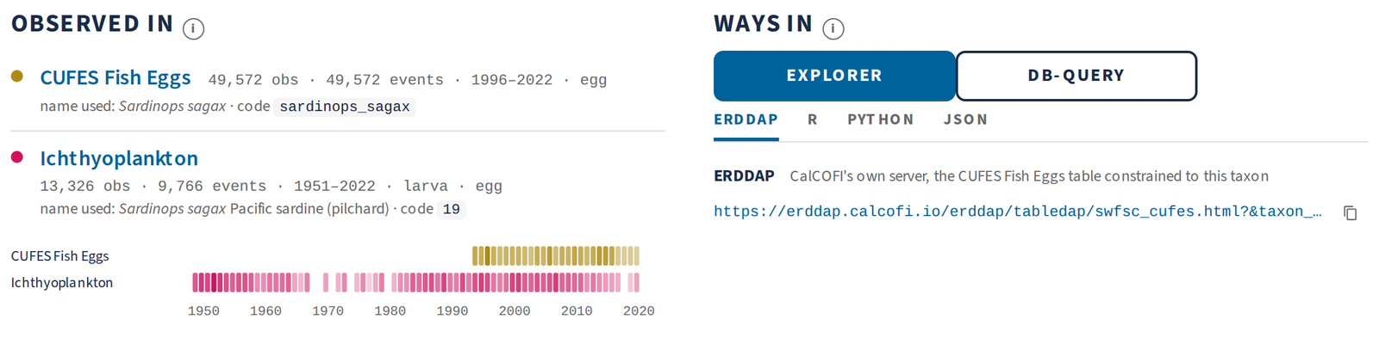
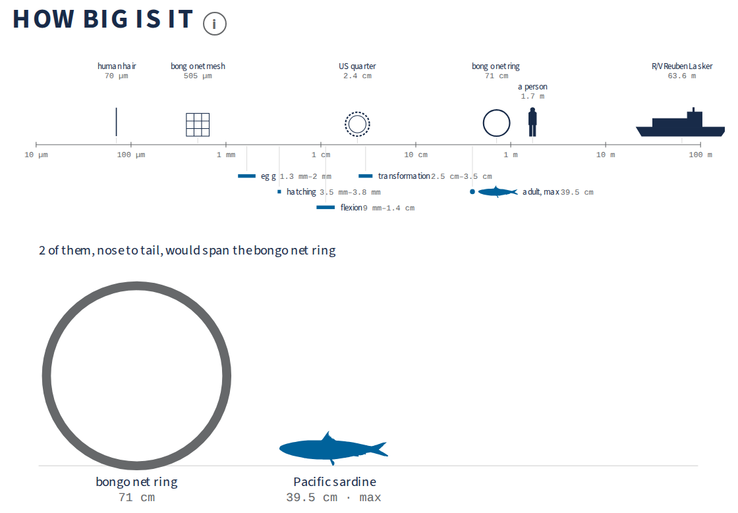
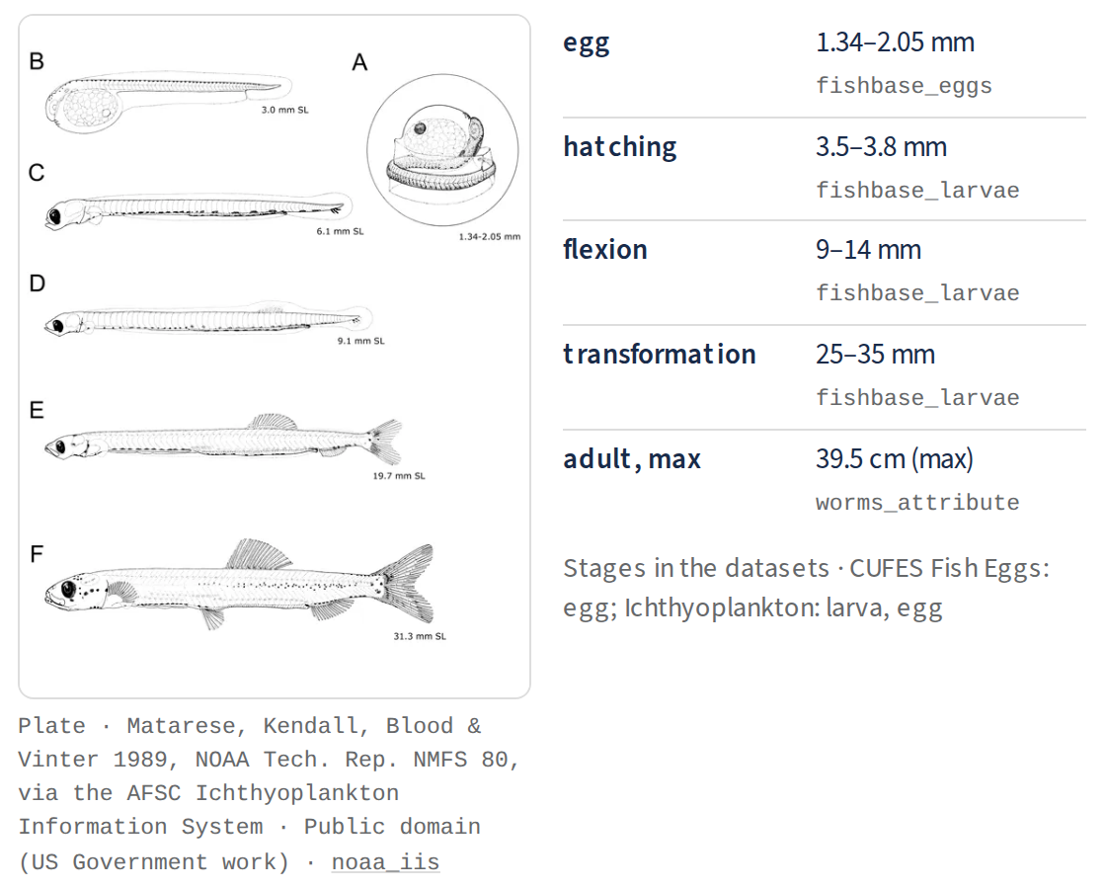
SPECIES · ONE PAGE, BELOW THE FACE
WHERE IT WAS COUNTED, HOW BIG, HOW TO GET IT
Observed in: one row per dataset, with the name that dataset uses (code 19, sardinops_sagax) and a years strip.
How big is it: a log ladder from a human hair to R/V Reuben Lasker, with egg, hatching, flexion, transformation and adult.
Larval plate for 158 fishes: Matarese et al. 1989, via NOAA AFSC — public domain.
Ways in: Explorer and db-query buttons; ERDDAP · R · Python · JSON as tabs.
calcofi.io/species/worms-217452/
CalCOFI.io update · 2026-09-23 · 9
Notes:
Below the face, the record. Observed in: one row per dataset — observations, sampling events, years, life stages — ending in the name that dataset uses, with a quiet pill where it is not the accepted name (synonym, sp. → genus, re-keyed, code only), and a years strip, one row per dataset. How big is it: a log ladder 10 µm → 100 m with six sourced references (a human hair, the bongo net mesh, a US quarter, the bongo ring, a person, R/V Reuben Lasker) and the taxon's marks under the axis — for fishes the egg, hatching, flexion and transformation lengths from FishBase — then the silhouette to scale beside the nearest reference ('2 of them, nose to tail, would span the bongo net ring'); no length on record means nothing is drawn, never a typed number. The larval plate: for the 158 fishes the AFSC Ichthyoplankton Information System covers, the plate from Matarese, Kendall, Blood and Vinter 1989 (NOAA Tech. Rep. NMFS 80), public domain; a courtesy email to AFSC was drafted. Ways in: Explorer (prefilled ?taxon=) and db-query (a prefilled SELECT … FROM obs_bio) as buttons, then ERDDAP · R · Python · JSON as a tabset since round 2 — the page as data is {slug}.json. Sources: plan 2026-09-11 'Species faces' D3, D5; plan 2026-09-09 D8.4; plan 2026-09-15 WS-R5 (P1–P3).

Slide 10

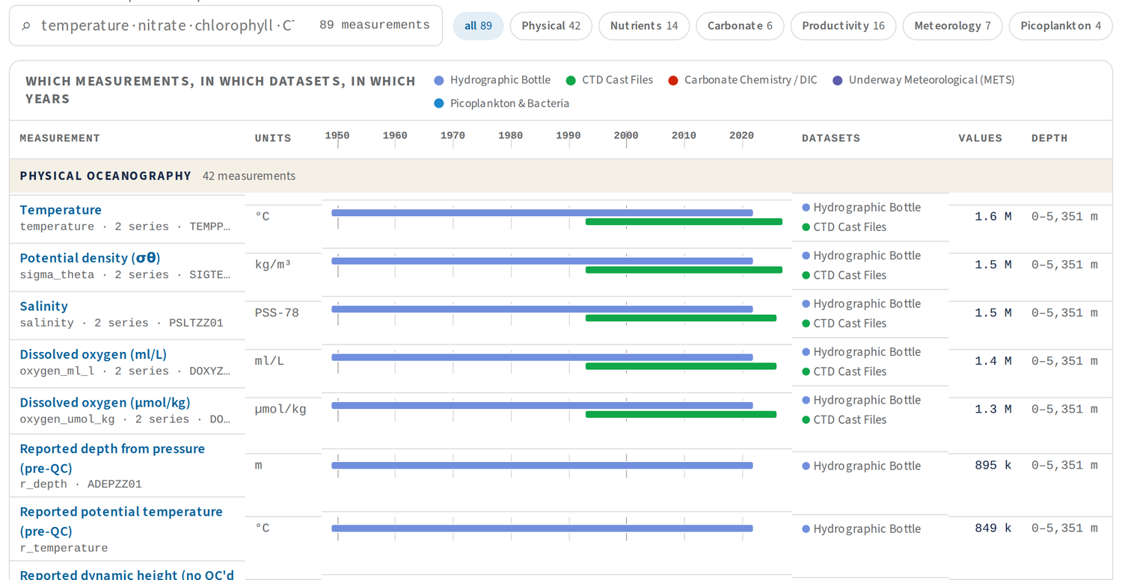
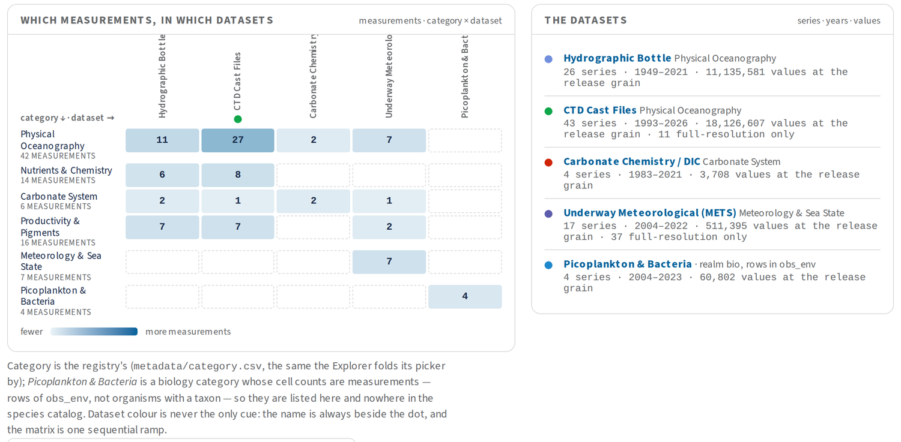
MEASUREMENTS · CALCOFI.IO/MEASUREMENTS
MEASUREMENTS: ONE NAME PER QUANTITY
89 measurements · 94 series · 5 datasets; 30 M values at release grain, 325 M at full resolution; 51 with a NERC concept.
One name only where concept, units and kind of sample match and they are not the same bottles: bottle temperature + CTD average = Temperature.
The timeline table: one bar per dataset, 1949 → 2026; hover for series, flag and NERC id.
calcofi.io/measurements/
CalCOFI.io update · 2026-09-23 · 10
Notes:
Your ask on 9/10: the environmental analogue of Species. /measurements/ lists everything measured in the water and the air above it: 89 measurements, 94 series, 5 datasets, 30 M values at the release grain (obs_env) and 325 M counting the full-resolution CTD and underway tables, 51 with a NERC P01 concept. The crosswalk rule: two datasets' series share one measurement page only where (i) the NERC P01 concept is identical, (ii) the units match or convert by declaration, (iii) the samples are the same kind (cast profile with cast profile) and (iv) they are not plausibly the same physical samples. So the bottle dataset's temperature and the CTD's temperature_ave are one page, Temperature; the CTD files' own btl_* series stay their own keys (they are probably the same bottles, which would count them twice), and replicates stay apart as questions to providers. Labels live in a registry, metadata/variable.csv, read with read_variable(). The index shows the category × dataset matrix, the datasets list, and the centrepiece timeline — one row per measurement grouped by category, one bar per dataset first to last year, then units, datasets, values, depth — with search and category chips. Picoplankton still appear here as 4 measurements; at the next release they move to Species (obs_bio, 60,802 rows keyed by WoRMS), taking this to 85 keys / 90 series. Sources: plan 2026-09-10 'Measurements catalog' D1–D5 and § Measured; RELEASES.md § measurements.json and # Unreleased; calcofi4db 4.12.0.

Slide 11
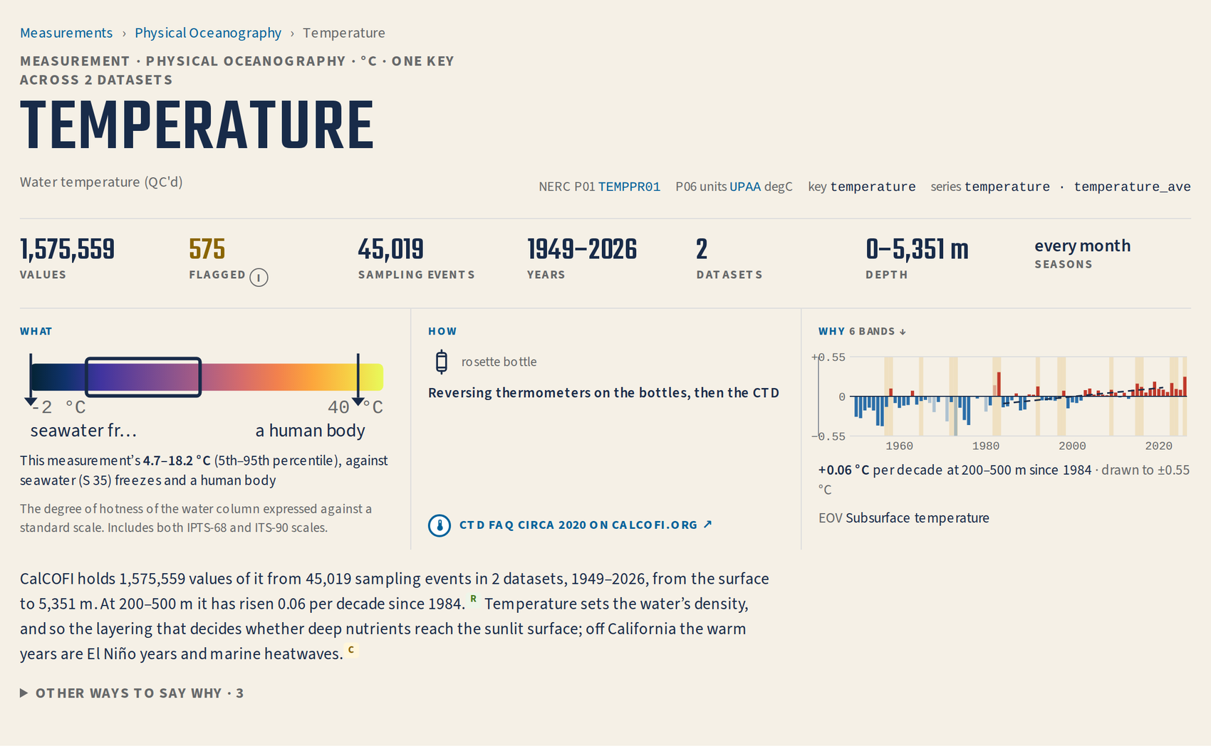
MEASUREMENTS · ONE PAGE
EVERY MEASUREMENT: WHAT, HOW, WHY
What: the variable’s own colour ramp over its declared bounds, the record’s 5–95 % window, and familiar marks — seawater freezes · a human body.
How: the method card, linked to its page on calcofi.org — 81 of 89 pages; none linked before round 2.
Why: the anomaly by depth band against the 1993–2013 normal, El Niño years shaded — +0.06 °C per decade at 200–500 m since 1984.
575 flagged is a pill; its ⓘ says what the Explorer and your code leave out.
calcofi.io/measurements/temperature/
CalCOFI.io update · 2026-09-23 · 11
Notes:
Your ask on 9/11: give measurements a face — what is measured, how, and why it matters for the ocean's health. The face row is three columns. What: by what NERC says the thing is — for a property like temperature, the scale face: the variable's own cmocean ramp (thermal here) over the registry's declared bounds (−2 … 40 °C), the record's 5–95 % window (4.7–18.2 °C for the bottles) and sourced familiar marks (seawater of S 35 freezes at −1.91 °C, computed with gsw; a human body 37 °C). How: one card per series from the method registry (instrument, principle, precision), with a pin that links calcofi.org's method page at a text fragment, like the front door's pins — 81 of the 89 pages carry it since round 2 fixed a column-name bug that meant no page had ever linked calcofi.org. Why: the per-band anomaly against the release's own 1993–2013 climatology, 1984–2021 trend, strong El Niño years from NOAA's ONI shaded; the head's spark is the band with the most values (200–500 m, +0.06 °C per decade), drawn to its own ±0.55 °C. The sentence: CalCOFI's numbers (R badge) plus one cited 'why' (C badge) — Bond et al. 2015 here — with 'other ways to say why · 3' folded. The stats: 1,575,559 values · 575 flagged · 45,019 sampling events · 1949–2026 · 2 datasets · 0–5,351 m · every month. Sources: plan 2026-09-11 'Measurement faces' D1–D7 and § Measured (WS-MF1–MF4); plan 2026-09-15 WS-R2, WS-R3; calcofi4db 4.15.0 (measurements.json 1.1).

Slide 12

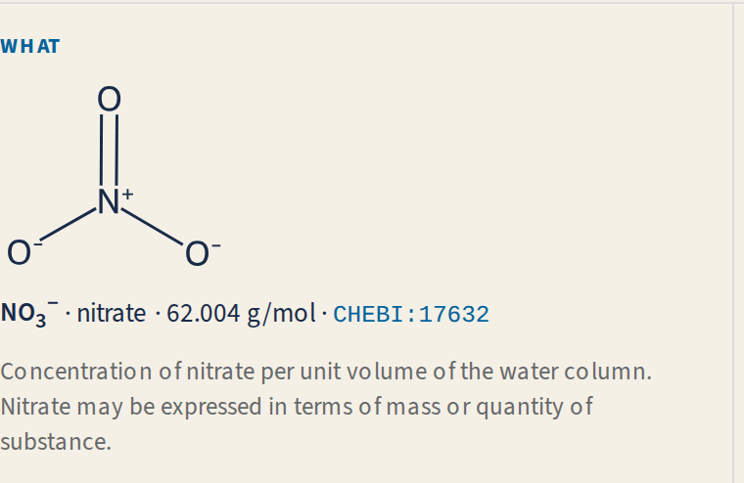
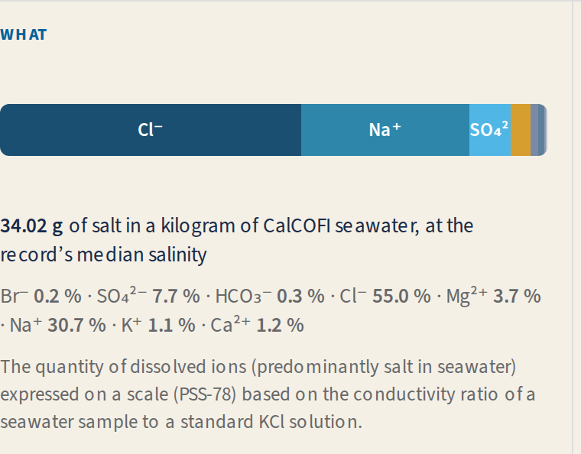
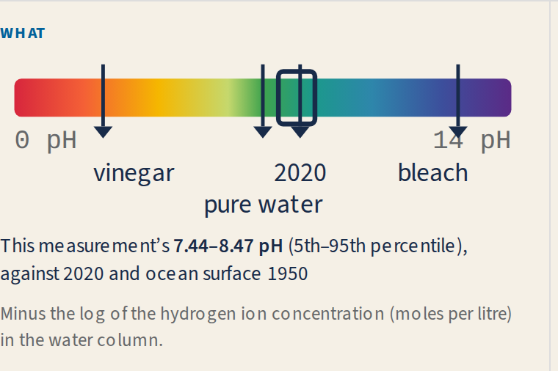
MEASUREMENTS · THE FACES
A FACE DRAWN FROM WHAT THE THING IS
Structure — NO₃⁻ from ChEBI’s molfile, drawn by RDKit in the page’s own ink.
Composition — 34.02 g of ions in a kilogram of seawater at the record’s median salinity.
Scale — pH on the indicator strip; wind on the Beaufort cells.
51 keys have a NERC concept — 26 structures, 13 compositions, 10 scales, 2 organisms. The rest stand in for what they estimate (19; an ISUS voltage wears nitrate’s face) or show their scale alone (16). Every mark is sourced or recomputed at build (gsw, PyCO2SYS).
calcofi.io/measurements/nitrate/
CalCOFI.io update · 2026-09-23 · 12
Notes:
Four faces and a fallback, chosen by what NERC says the thing is. Structure (26 keys with a concept): the entity reached only by identity, P01 → S27 → ChEBI, ChEBI's molfile drawn by RDKit in the page's ink — no image from Commons or PubChem ('draw ourselves', your 9/11 answer); 53 keys end up with a drawn structure, 56 ChEBI records. Composition (13): salinity as TEOS-10's mass fractions — 34.02 g of ions per kilogram at the record's median salinity, Cl⁻ 55.0 %, Na⁺ 30.7 % —; DIC as CO₂ + HCO₃⁻ + CO₃²⁻ at the record's surface medians (PyCO2SYS 1.8.3). Scale (10): a property's familiar scale — pH on the universal indicator strip, wind on Beaufort cells. Organism (2): picoplankton reach their species face. Of the 38 keys without a P01, 19 borrow the face of what they estimate with a 'stands in' chip and no borrowed ids, 16 show only their scale, and one (uws_flow) shows nothing. Every familiar mark is sourced in measurement_scale.csv; computed ones name their function and inputs and are recomputed at build (gsw.t_freezing, gsw.O2sol, PyCO2SYS). Worth seeing live: dissolved oxygen, −7.26 µmol/kg per decade at 200–500 m since 1984. Polish seen while making this slide: the pH strip's labels crowd ('2020' over 'pure water', the arrow on '14 pH'). Sources: plan 2026-09-11 'Measurement faces' D1–D3, D7, § Measured WS-MF1, WS-MF4; the probe numbers in § Measured.

Slide 13

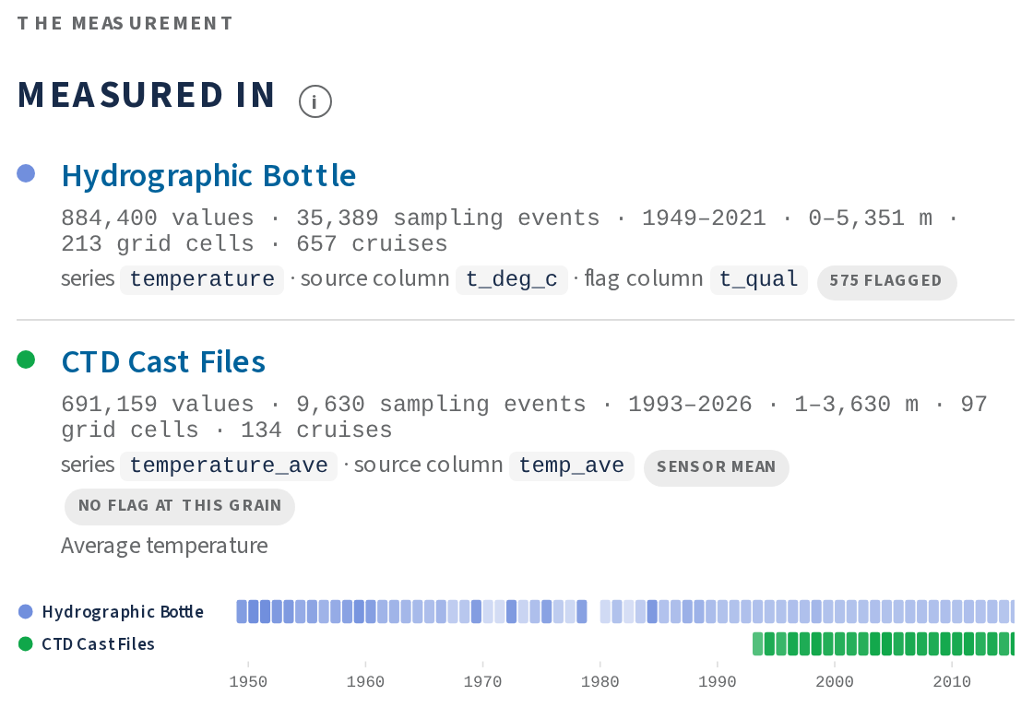
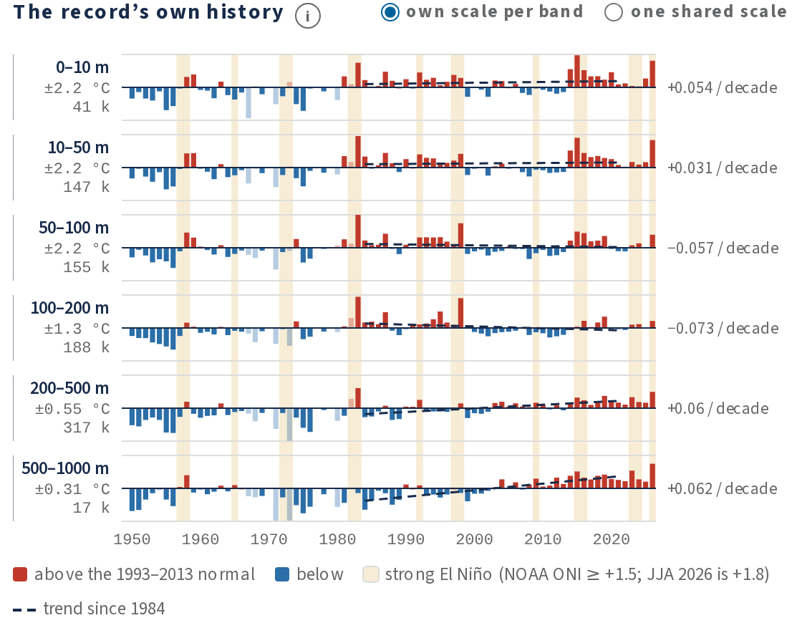
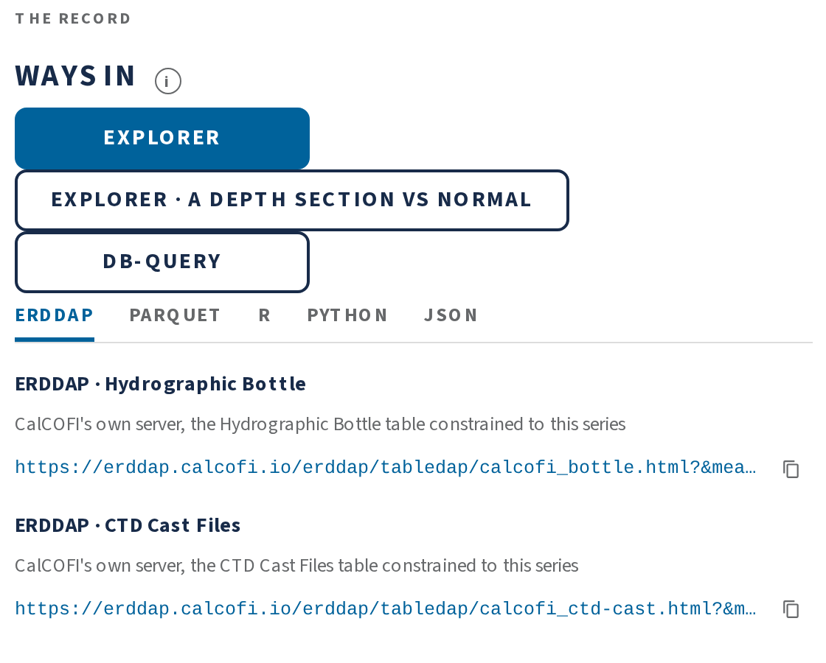
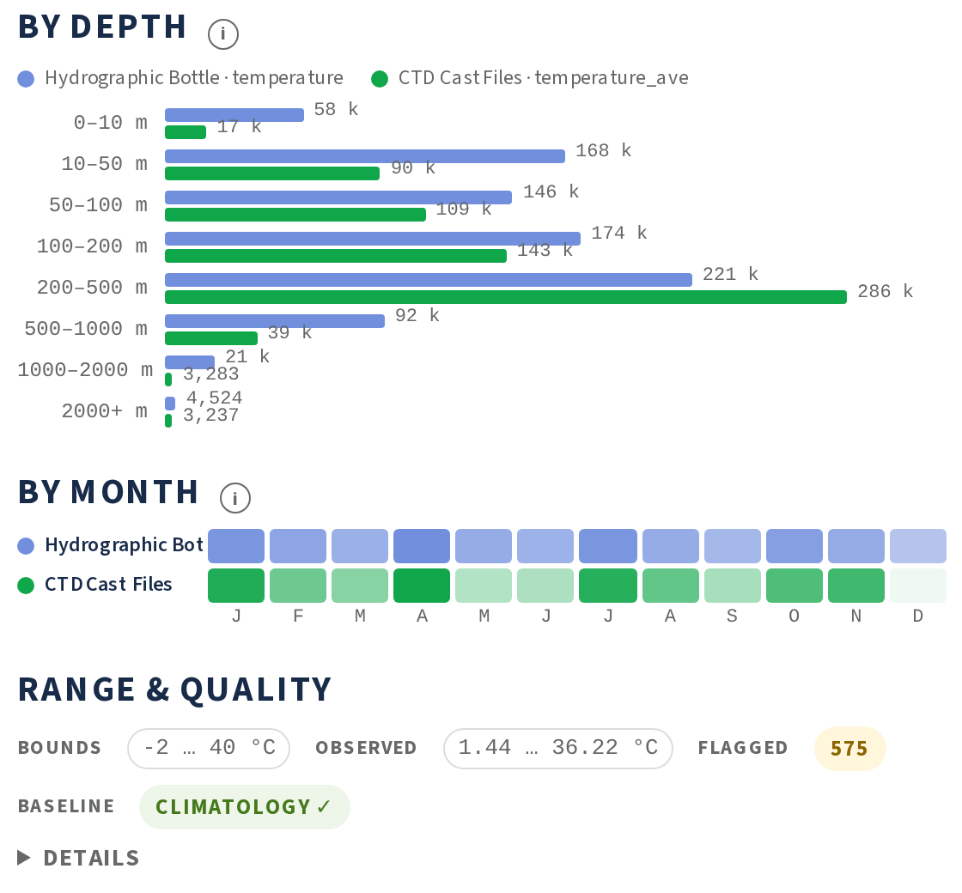
MEASUREMENTS · ONE PAGE, BELOW THE FACE
THE RECORD, ITS HISTORY, AND EVERY WAY IN
Measured in: each series with its source column, flag column and pills (sensor mean, no flag at this grain).
The record’s own history: anomaly per depth band, each on its own scale, trend since 1984.
Ways in: Explorer (or a depth section vs normal), db-query; ERDDAP · Parquet · R · Python · JSON as tabs.
By depth · by month · range & quality: bounds, observed, flagged and baseline in one line.
calcofi.io/measurements/temperature/
CalCOFI.io update · 2026-09-23 · 13
Notes:
Below the face, two columns as concepts since round 2: the measurement (measured in, structure, how, why) and the record (ways in, depth, month, quality, related, cite). Measured in: one row per series — Hydrographic Bottle temperature (884,400 values, 1949–2021, source column t_deg_c, flag column t_qual, 575 flagged) and CTD Cast Files temperature_ave (691,159 values, 1993–2026, source temp_ave, a sensor mean with no flag at this grain because it is rebuilt from the flagged sensors) — plus a years strip. The record's own history: the anomaly per depth band against the 1993–2013 normal, own scale per band by default (a toggle gives one shared scale), trend since 1984 per band, El Niño years shaded, one-cruise years faded. Ways in: Explorer on ?var=, Explorer's depth section vs normal, db-query with the query in the shell, then ERDDAP per series · Parquet through the catalog · R · Python · JSON as a tabset. By depth (eight bands, one bar per dataset), by month, and Range & quality as one chip line — bounds −2 … 40 °C · observed 1.44 … 36.22 °C · flagged 575 · climatology ✓ — with the details folded. Related measurements (Bottle temperature from the CTD files' own bottles, kept apart with the reason) and Cite close the page. Sources: plan 2026-09-15 WS-R3 and § Measured; CalCOFI.github.io 92eb07d.

Slide 14

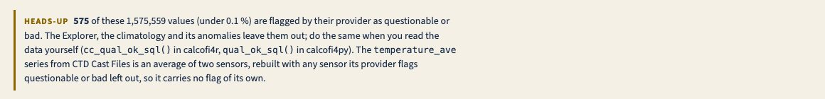
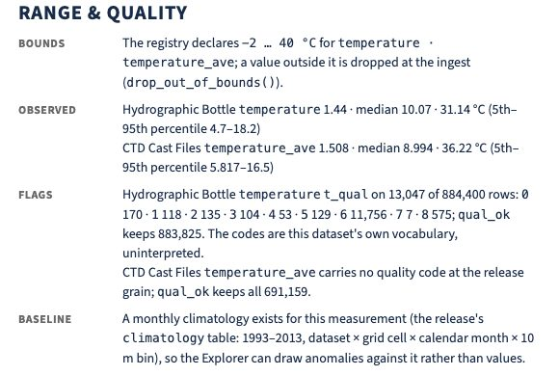
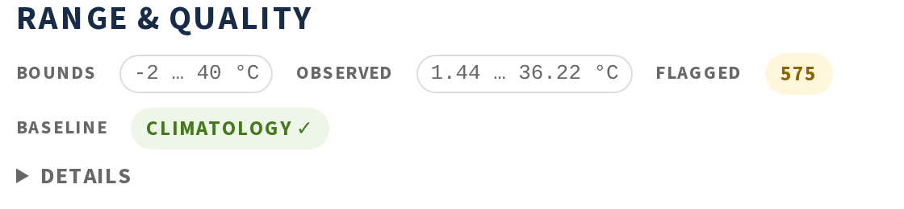
SPECIES & MEASUREMENTS · ROUND 2
LESS TEXT, MORE FIGURE
BEFORE · 9/15
Temperature’s page: 6,604 → 3,589 px tall at 1280 wide (−46 %).
Six idioms, the same on every page: pill + ⓘ · tabsets · say it once · draw to a scale · a licence chip · one rule.
AFTER · 9/16
24 findings across six pages, fixed in five parallel branches and merged 9/16 — and two old bugs found on the way (no page had ever linked calcofi.org; two variables matched the wrong ramp).
BEFORE
AFTER
calcofi.io/measurements/temperature/
CalCOFI.io update · 2026-09-23 · 14
Notes:
Your review on 9/15: the realized faces fell short of the mockup and every page was overwhelming with text. Round 2 is a register of 24 findings over six pages (measurement page, measurement face, species page, species index, datasets, a dataset page) and six idioms applied everywhere: a count or a state is a pill and its explanation opens behind an ⓘ (the four-line heads-up became the flagged stat); parallel alternatives are a tabset (ways in, methods, access); a fact lives in one place and the second place links (What it is and Where in the water column dropped); a figure has a ramp or an axis, labels and a hover (the spark got its band's own scale, 2.20 → 0.55 °C, and year ticks); a licence wears its own chip; and one rule on every page. Result: temperature's page 6,604 → 3,589 px at 1280 wide; front door DATA section 3,117 → 2,948 px. Found on the way: how_rows() read registry columns the record does not carry, so no page had ever linked calcofi.org (now 81 of 89); and the Explorer's defaultRamp() matched sigma_theta to thermal and wind direction to speed (fixed in explore beec8cf, mirrored on the site). Five workstreams ran in parallel branches (ws-r1 … ws-r5, plus explore ws-r6) and merged 9/16 as landing PR #25 and Explorer PR #11. Before shots: the live site on 9/15; after: local build of main on v2026.09.11. Sources: plan 2026-09-15 'faces round 2' findings M1–M14, D1–D5, S1–S2, P1–P3, I1–I2 and § Measured.

Slide 15

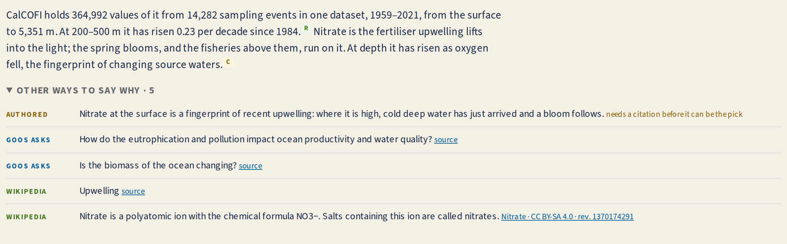
YOUR CALL · QUOTATIONS
WHICH WORDS DO WE QUOTE?
Behind every “why” on 89 pages:
88 authored picks, each cited
117 authored alternatives
146 Wikipedia leads
69 GOOS questions
2 in calcofi.org’s own words
calcofi.io/measurements/nitrate/ — the sentence, then “other ways to say why · 5” opened.
Sign-off: should a CalCOFI scientist approve each pick? Today there is no human review gate.
Wikipedia: keep as an alternative, or drop? Some render as a bare title (“Upwelling”), and the sardine’s lead describes the genus.
GOOS questions verbatim — or only where the sheet asks one?
Ask calcofi.org for its own sentence per measurement (2 today)?
calcofi.io/measurements/nitrate/
CalCOFI.io update · 2026-09-23 · 15
Notes:
This is the first of two discussion slides — the question you raised: which quotations to use and which to drop. Every measurement page says why it matters in one sentence, the pick, and folds the rest under 'other ways to say why · n' (nitrate, left, has five). The registry, measurement_why.csv, has 422 rows over 88 of 89 keys: 88 rank-1 picks across 29 concepts, all authored (drafted with Claude) and each cited — 22 new BibTeX entries, every DOI resolving and every abstract read; alternatives are 117 more authored lines (an uncited one is labelled 'needs a citation before it can be the pick'), 146 Wikipedia leads (CC BY-SA 4.0, linked to the revision), 69 GOOS questions quoted from the Essential Ocean Variable specification sheets (4 of the 8 sheets carry no scientific question, so those keys link the sheet), and 2 in calcofi.org's own words. The plan set no human review gate — that is question 1. Question 2: Wikipedia — nitrate's 'Upwelling' alternative renders as a bare title with no lead, and on species pages the sardine's lead sentence describes the genus Sardinops (Wikipedia has no species article); keep, flag, or drop? 3: GOOS questions as-is? 4: would calcofi.org's web team write one sentence per method or measurement, so the pick can be CalCOFI's own words? Sources: plan 2026-09-11 'Measurement faces' D5 and § Measured WS-MF2; workflows metadata/measurement_why.csv (counted 2026-09-23).

Slide 16


YOUR CALL · SCOPE AND STYLE
TOO MUCH, TOO LITTLE, OR ANOTHER WAY IN?
Too much or too little?
Other ways in?
At 1440 wide a species page runs ≈ 2,550 px, temperature ≈ 2,920 px: fold How big and the plate behind a tab?
By place: what was counted or measured at station 90.30 → the Explorer there.
Overviews: tree + matrix + icicle; timeline + matrix — drop the icicle, or add a map?
By life stage and season; by question (the GOOS / EOV questions as doors).
Photo-first or silhouette-first? Life-stage photos (the krill’s nauplius) OK?
Compare two species or measurements on one page.
Seen while shooting these slides: pH’s labels overlap; temperature’s “seawater fr…” truncates; wind’s method pin reads “not found on calcofi.org”; picoplankton are still measurements until the next release moves them to species.
calcofi.io/species/
CalCOFI.io update · 2026-09-23 · 16
Notes:
The second discussion slide: is it too much or too little, and should there be other searches or styles? Length at 1440 px wide (the local build): the sardine page is about 2,550 px, temperature about 2,920 px (3,589 px at 1280 wide after round 2). Candidates to fold: the How big ladder and the larval plate behind a tab on species pages; the icicle on the species index (the tree and matrix already answer 'which species in which dataset'). Candidates to add: a map, which the pages deliberately left out because the Explorer is one click away. Other ways in, none built: by place ('what was counted or measured at station 90.30', opening the Explorer on that station), by life stage (egg, larva, juvenile, adult) and season, by question (the GOOS / EOV questions as a doorway into measurements), and a compare-two page. Style: photo-first vs silhouette-first; life-stage photos — the Pacific krill page shows a hatching nauplius (a real photo of the species, not an adult). Polish noticed while shooting these slides from a local build of main on v2026.09.11: the pH strip's '2020' label sits over 'pure water' and the arrow over '14 pH'; temperature's familiar mark label truncates to 'seawater fr…'; the wind page's method pin reads 'not found on calcofi.org' (the underway page on calcofi.org is a client-rendered shell); picoplankton are listed as 4 measurements until the next release moves them to obs_bio. Sources: the page lengths are the local build's full-page heights; plan 2026-09-15 § Measured; RELEASES.md # Unreleased.

Slide 17

PLACE · THE PROBLEM
AN INSHORE GRID CELL HELD UP TO FIVE STATIONS
Grid cell | Stations it holds | Per cruise
st30-ln90 | 90.30 · 90.28 · 90.27.7 (SCCOOS) · 88.5/30.1 | 3.67
st35-ln86.7 | 86.7/35 · 86.7/33 · 86.7/32.5 · 85.4/35.4 · 85.4/35.8 | 3.22
st40-ln83.3 | 83.3/40 · 83.3/39 · 83.3/40.6 · 83.3/42 · 84.0/41.7 | 2.88
st25-ln93.3 | 93.3/26.4 · 93.3/26.0 · 93.3/26.7 · 93.4/26.x · 91.7/26.4 | 2.69
16.6 %
of CTD occupations never drew in ctd-transects — 1,595 of 9,637
26 %
CTD cast occupations per cruise in each inshore cell, measured on v2026.09.06; each cell occupied every cruise since 2004.
on line 90 since 2004
Three products, three answers within 30 km of the coast: the plotter kept the first cast, the Explorer averaged the cell, the climatology pooled it.
github.com/CalCOFI/workflows/issues/86
CalCOFI.io update · 2026-09-23 · 17
Notes:
Found while answering Rasmus on 9/9 about the calmer contours. grid_key is a point-in-polygon into the 218 cells of the CalCOFI grid, and the inshore cells of the core lines are ~2,350 km² boxes that hold two to five real stations, all occupied every cruise since 2004 — st30-ln90 holds 90.30, 90.28, 90.27.7 (a SCCOOS station) and 88.5/30.1. ctd-transects did QUALIFY row_number() OVER (PARTITION BY cruise_key, grid_key) = 1, keeping whichever station the ship reached first: 1,595 of 9,637 CTD occupations (16.6 %) never drew, 26.1 % on line 90 since 2004 (23.8 % line 83.3, 17.8 % line 86.7, 16.7 % line 93.3), almost all within 30 km of the coast. Meanwhile the Explorer's Sections lens averaged the casts in a cell and build_climatology() pooled them into one baseline cell — three products, three different answers exactly where the gradient is steepest. Rasmus's reply: 'A SCCOOS station is very different from a deep water station like 90-30' — keep them separate. Also closed on the way: the earlier climatology non-determinism was fixed in calcofi4db 4.1.1 and shipped in v2026.09.06. Sources: plan 2026-09-09 'Next two weeks' § The coast (measured on v2026.09.06); RELEASES.md v2026.09.10 § The climatology and the sections key on the station; the 'Next Two Weeks Tasks' thread (9/9); CalCOFI/workflows#86.

Slide 18

PLACE · THE FIX
THE CLIMATOLOGY KEYS ON THE STATION
One spelling per station
The climatology on the station
site_key = printf('%05.1f %05.1f', line, station) → 090.0 028.0. 28 CTD casts carried the source’s spellings (“93.3 26.4”, “0093. 060.0”): normalized at ingest, checked at release.
Grained on dataset × site_key × month × 10 m bin × measurement; grid_key stays as the station’s modal cell (709 of 9,705 stations straddle a cell edge).
At least five cruises per cell
To the bottom
Rasmus, 9/9: ≥ 5 cruises (was 3). 577,113 of 768,880 cells survive (75 %); every row carries the n behind it.
The normal reaches the deepest bin with enough cruises: 500 → 720 m, 714,882 → 734,410 rows (+2.7 %).
Moved together: ctd-transects (PR #3), the Explorer’s Sections lens (PR #10) and cc_climatology() in calcofi4r 1.23.0, on calcofi4db 4.10.0 — inshore anomalies move by up to ~1 °C at the surface.
calcofi.io/docs/db.html
CalCOFI.io update · 2026-09-23 · 18
Notes:
The fix is to key sections and the climatology on the real station and keep the grid cell for maps and hexagons. site_key has one spelling everywhere — printf('%05.1f %05.1f', line, station), e.g. '090.0 028.0' — applied to every ingest's sample arm by append_sample() and gated at release by check_site_key_format(); v2026.09.06 had shipped 28 CTD casts carrying the source's own Sta_ID forms beside the canonical one. The climatology table (computed once per release, shared by the Explorer, ctd-transects and the R/Python packages) is now grained on dataset × site_key × calendar month × 10 m bin × measurement type, with grid_key kept as the station's modal cell; a cell-level reader pools rows by grid_key weighted by clim_n and gets exactly the old value. Rasmus's review raised the floor to at least 5 distinct cruises per cell (577,113 of 768,880 cells survive, 75 %; 87 % of CTD temperature cells; the METS cells drop out) and asked to show how many cruises made the baseline — clim_n and n_cruises stay on every row. Measurement faces then carried the climatology to the bottom: 500 → 720 m, purely additive. Consumers moved in the same release: ctd-transects PR #3 and Explorer PR #10 (branches site-key) and calcofi4r 1.23.0 cc_climatology(); calcofi4db 4.10.0 (site_key) and 4.15.0 (to the bottom). Inshore anomalies move by up to about 1 °C at the surface. Sources: RELEASES.md v2026.09.10 (both sections) and # Unreleased § The climatology goes to the bottom; plan 2026-09-10 'Measurement faces' § Measured WS-MF3; calcofi4db dfb8d37a; docs eb6b591, 33f990d.

Slide 19
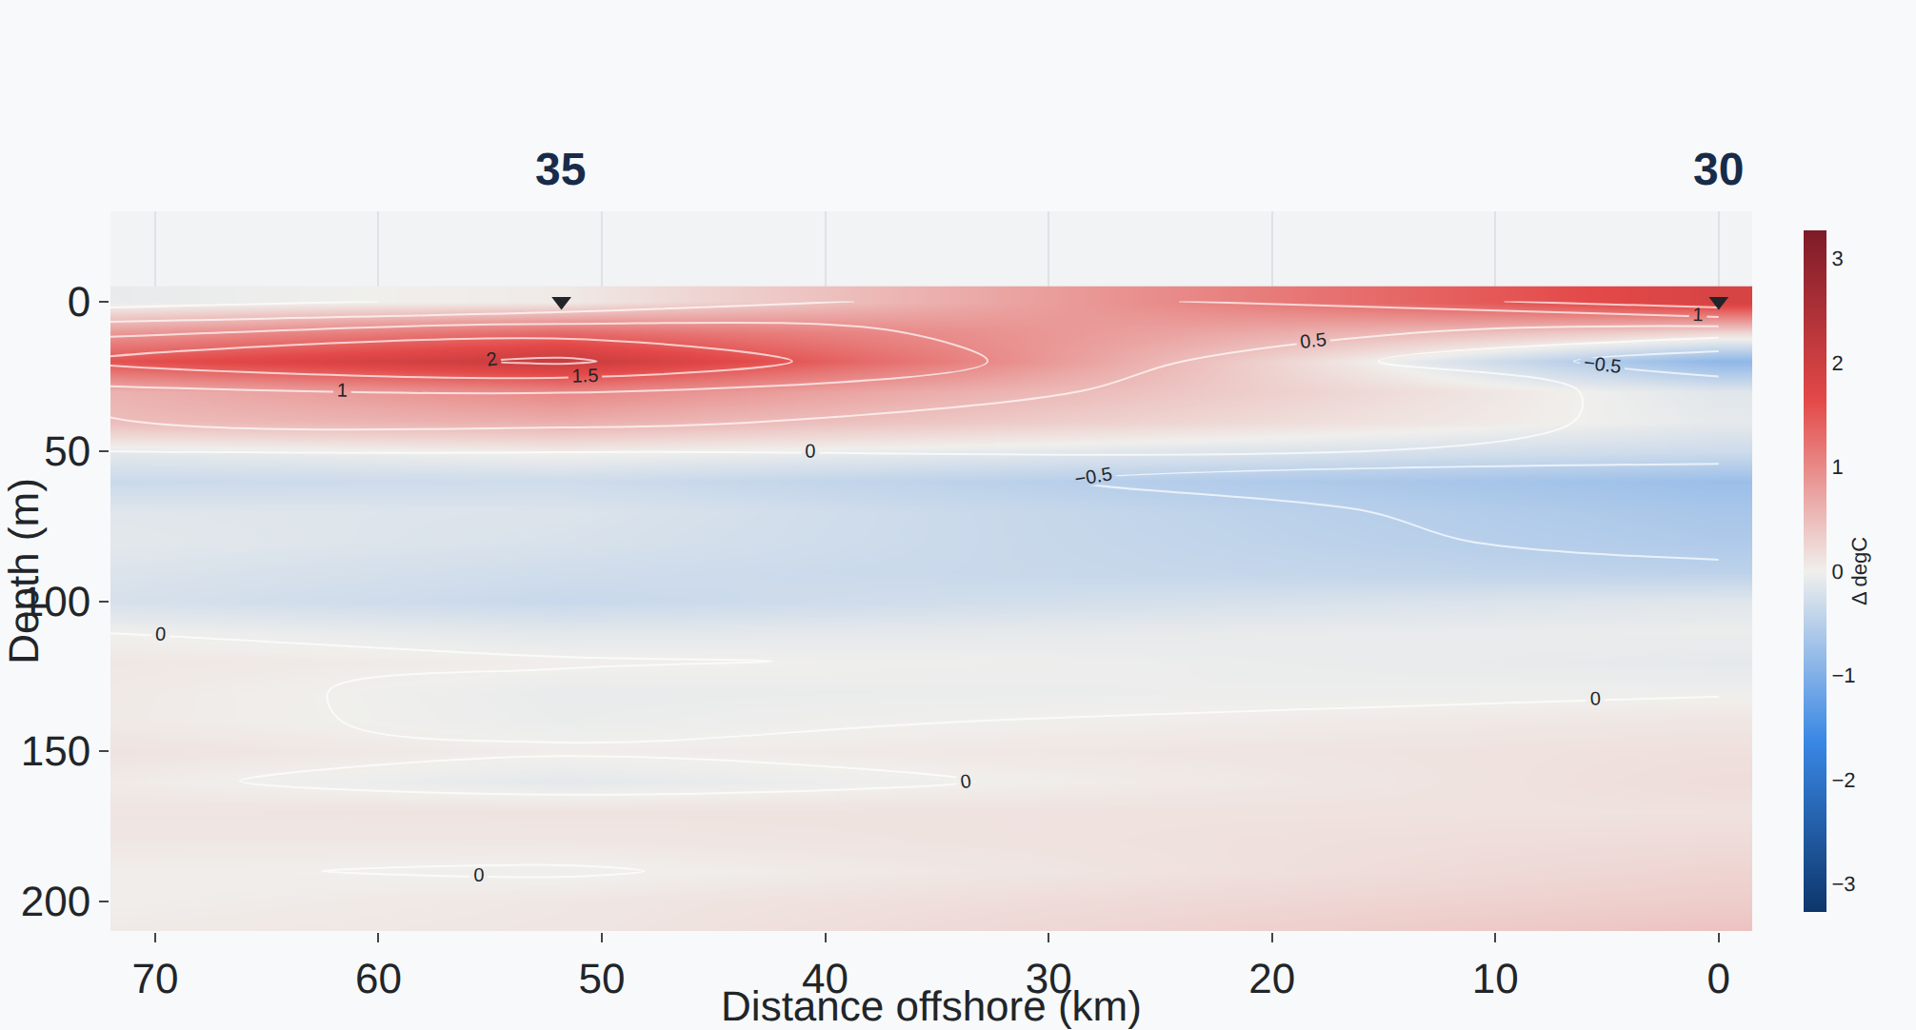
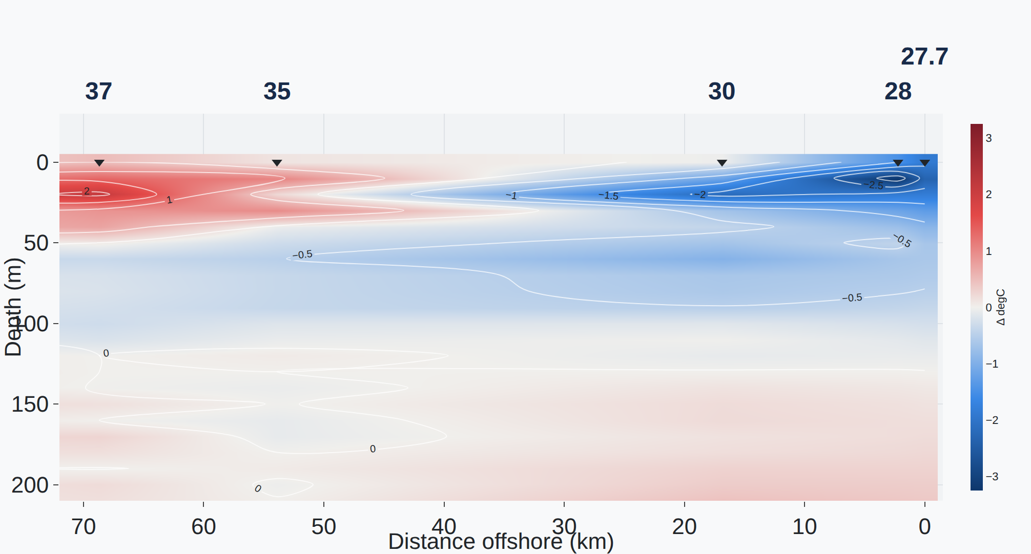
PLACE · BEFORE AND AFTER, CTD-TRANSECTS
LINE 90, AUGUST 2024: THE COAST COMES INTO FOCUS
BEFORE · V2026.09.06
AFTER · V2026.09.11
One cast per grid cell; the normal pooled over the cell (≥ 3 cruises).
Every station its own column and its own normal (≥ 5 cruises).
Stations 28 and 27.7 (SCCOOS) now draw, and a cold nearshore core (−2 to −2.5 °C) appears that the pooled column hid. Red is warmer, blue colder than the normal (°C); 0 km is the innermost station drawn.
calcofi.io/ctd-transects/ · line 90 · 2024-08 · anomaly
CalCOFI.io update · 2026-09-23 · 19
Notes:
The hero of the talk: the same section drawn by ctd-transects before and after — line 90, cruise 2024-08 (Sally Ride, preliminary CTD & bottle), average temperature as an anomaly against the release's 1993–2013 climatology, zoomed with Plotly to 0–72 km offshore and 0–210 m, station labels redrawn larger. Before (the app's committed build of 2026-09-07, release v2026.09.06): the cruise showed 11 of 19 stations on line 90; the inshore grid cell kept one cast, drawn as station 30 at 0 km, against a baseline pooled over the cell at ≥ 3 cruises. After (the bot's refresh of 2026-09-12 on origin/main, release v2026.09.11): 14 of 22 stations; 28 and 27.7 (SCCOOS) draw as their own columns, station 30 sits at 16.7 km, each against its own station's normal at ≥ 5 cruises — and the upwelling-cold core right at the coast (−2 to −2.5 °C at 5–20 m) appears. Read the two x-axes carefully: distance is measured from the innermost station drawn, so 0 km is station 30 on the left and 27.7 on the right. Two things changed at once — the station key and the baseline (its grain and its 5-cruise floor) — which is why I say 'comes into focus' rather than attributing each degree. Shots: both apps served locally from their own committed public/ folders (commits 2c99d0f3 and f9529d82), 1440 px at 2×; the map panel is left out because it needs a CDN file. Link: the live app with this cruise.

Slide 20
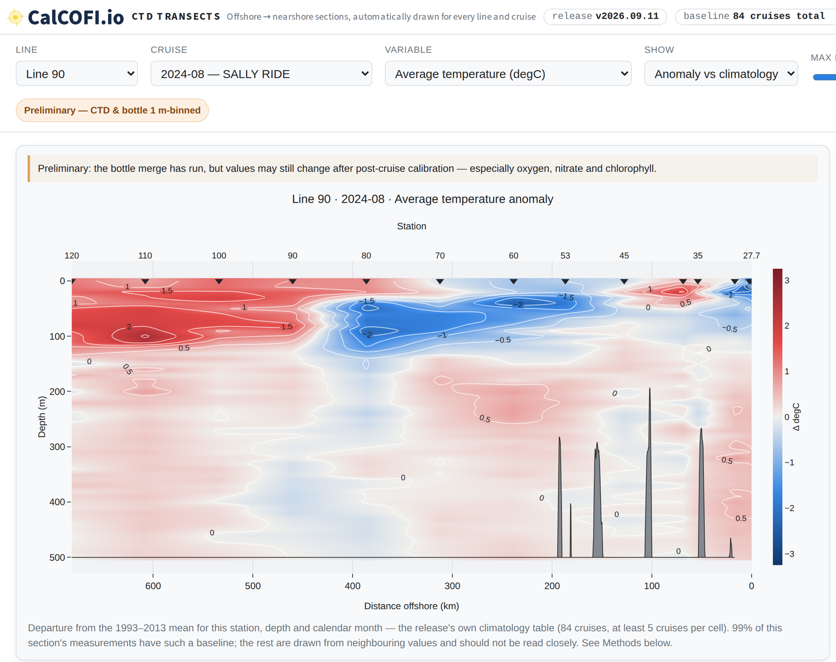
PLACE · CTD-TRANSECTS, IN REVIEW
RASMUS’S DATA STREAMS, IN BETTY’S PULL REQUEST
Variables follow the data stage: temperature only on sensor-only preliminary cruises; oxygen and chlorophyll-a as station- or cruise-corrected fits; the estimated-nitrate pair.
A baseline badge and a per-cell tooltip: how many cruises made the normal.
Station labels no longer collide near the coast.
Rasmus asked next: σθ from both sensors, spice, relative geostrophic flow (9/22); a monthly vs seasonal normal (9/9).
He keeps this simple plotter beside the Explorer — the quick way to show the incoming El Niño.
github.com/CalCOFI/ctd-transects/pull/4
CalCOFI.io update · 2026-09-23 · 20
Notes:
Rasmus asked on 9/8 for more data streams on the transect plotter, then answered the three questions on 9/9: recompute the sensor mean ourselves with the flag rule (yes); chlorophyll and nitrate from the corrected sensor estimates, at both station- and cruise-corrected levels, oxygen likewise, not the discrete bottles; sensor-only preliminary cruises stay temperature-only because a drifting or uncalibrated sensor reads badly in an anomaly. The ingest side shipped in v2026.09.10 (ten corrected CTD series became canonical). Betty's side is PR #4 (branch ctd-1-sensor-pair), waiting for my review: variables gated per processing tier, the station- and cruise-corrected variants, the EstNO3 pair, the climatology minimum up from 3 to 5 cruises, a per-cell tooltip and a header badge for how many cruises made the baseline (Rasmus's 'show the n'), and fixed station-label crowding. Shot: the PR's committed build (release v2026.09.11), line 90, 2024-08, anomaly, served locally; the Where-this-is map is cropped out. Next, from Rasmus's 9/22 email: SigThetaTS1 and TS2 averaged unless one is flagged; spice (gsw_spiciness0) and relative geostrophic flow (dynamic height with a 500 dbar reference, velocities between station pairs, no anomalies because it is relative) — he sent an R sketch with the Gibbs SeaWater package; later a monthly vs seasonal normal toggle and a bottle-database baseline at observed depths. In the 9/16 meeting he said he wants to keep this simpler plotter alongside the Explorer for quick looks and the public during the developing El Niño. Also from 9/22: on 2607 some offshore stations drop out — Kelsey's corrected files should fix that once they are in the Drive folder. Sources: 'Next Two Weeks Tasks' thread (9/8, 9/9, 9/22, Betty 9/22); Tactiq '2026-09-16 CTD data on EDI discussion'.

Slide 21
TRUST · THE CTD, RELEASE V2026.09.11
SENSOR AVERAGES REBUILT FROM RASMUS’S FLAG RULE
Sensor 1 + sensor 2, each with the provider’s flag
Before, a flagged sensor slipped into the mean whenever its value was possible: 1,425 temperature and 6,001 salinity averages.
flag 8 or 9 → that sensor is left out
Faults with no flag at all: salinity at half of sensor 1 (≈ 17 PSU to 1,041 m) on 1998-07 and 2024-01; 35–40 °C at 1–2 m on 17 casts of 2003-04.
flag 1 or 2 → the primary or the secondary
Predicted: temperature 34,923 averages changed; salinity 39,276; oxygen 2.66 M changed and 1.14 M filled.
otherwise the mean; one alone if the other is missing
Impossible values leave at ingest: the 9,895 °C sea surface, the −99 flow, 45.6 PSU; six nitrates of 66–95 µmol/L.
combine_sensor_pair() · calcofi4db 4.11.0 · R and SQL twins, tested
RELEASES.html#v2026.09.11
CalCOFI.io update · 2026-09-23 · 21
Notes:
The CTD's canonical temperature, salinity and oxygen are averages of a sensor pair, and the files ship that average pre-computed. Since v2026.09.11 the ingest rebuilds every average (temperature_ave, salinity_ave_corr, oxygen_ml_l_ave_sta_corr, oxygen_umol_kg_ave_sta_corr) with the rule Rasmus set on 9/9, implemented once as calcofi4db::combine_sensor_pair() (4.11.0) with an SQL twin: a sensor flagged 8 (questionable) or 9 (bad) is left out; a 1 or 2 selects the primary or secondary; otherwise the mean; one sensor alone when the other is missing; the CTD team's accepted flags are applied to the sensors first. Until then the averages were repaired by physical bounds alone, which let a flagged sensor into the mean whenever its value was possible (1,425 temperature and 6,001 salinity averages in v2026.09.10) and could not see failures with no flag: on 1998-07-32NM and 2024-01-33UD SaltAve_Corr was exactly half of sensor 1 (≈ 17 PSU down to 1,041 m) and TempAve wrong by up to 10 °C; on 17 casts of 2003-04-31JD TempAve read 35–40 °C at 1–2 m beside a sensor at 12–14 °C. Predicted against v2026.09.10 by a dry run: temperature 34,923 changed, 238 filled, 1,434 removed; salinity 39,276 / 811 / 1,141; oxygen ml/L 2,656,233 changed and 1,135,319 filled; µmol/kg 3,529,141 filled. The corrected sensor series now carry their own flag in measurement_qual so any consumer can apply the same rule. What remains is single-sensor faults with no flag — the CTD team's to flag. Physical bounds declared at ingest since v2026.09.10: the 9,895 °C sea surface, the −99 flow, negative depths, 45.6 PSU and PAR fills (METS/CTD), and bottle nitrate −1…60 µmol/L. Sources: RELEASES.md v2026.09.11 § CTD averages rebuilt, § Bottle; v2026.09.10 § Six underway and CTD series declare their physical bounds.

Slide 22

TRUST · THE CTD CAST DATASET
WHAT RASMUS AND MARINA SETTLED, 9/16–9/18
Topic | What we settled | Where
Data stages | final · preliminary with bottle · preliminary sensor-only — confirmed; sensor-only is fine on calcofi.io and .org, not on EDI | Sheet 9/17 · meeting 9/16
EDI package | today’s CTD profile CSV + a unique id linking to the portal; tables by decade in one package; CC BY 4.0; quarterly, via DataZoo | Meeting 9/16
Quality codes | 0 good · 1/2 sensor used · 3 observed · 4 zeroed below detection · 7 interpolated to a standard depth; any code > 9 → blank | Sheet 9/18
Out of range | treat as absent; filter −99 before averaging; exclude unrealistic pH | Sheet 9/17–18
Bottle vs sensor | serve both the bottle’s analytical value and the bottle-corrected sensor reading | Sheet 9/17
Still open | archive vs calcofi.org copies of 66 cruises → Jim Wilkinson; out-of-range derived oxygen corrections — which cruises? | Sheet 9/18
calcofi.io/datasets/calcofi_ctd-cast/
CalCOFI.io update · 2026-09-23 · 22
Notes:
Settled in the 9/16 'CTD data on EDI' meeting (Rasmus, Marina, Erin, Betty, me) and in Rasmus's answers in the CalCOFI questions Sheet on 9/17–18. Data stages: sample.data_stage carries three values, most advanced first — final (Final 1 m-binned), preliminary_with_bottle, preliminary_without_bottle — derived from the file name and verified against content; Rasmus confirmed the labels and that sensor-only preliminary data are fine on calcofi.io and calcofi.org but should not go to EDI (as of v2026.09.06: 113 final cruises 1993–2021, 16 with bottle 2021–2025, 5 sensor-only 2025–2026). EDI: follow the current CTD profile CSV (hydrography plus chlorophyll-a), add the unique identifier so users can link back to the portal database, CC BY 4.0 as used for the hydrographic data so far (Erin to check NOAA constraints), several tables in one package split by decade so an update replaces only the latest, quarterly or when a cruise reaches 'preliminary with bottle', handed to Marina for DataZoo, which generates the EML and uploads to EDI; she asked that column types stay stable between updates. Quality codes: 0 good, 1 and 2 which sensor was used, 3 observed (for PRODO, dark-bottle cruise average), 4 zeroed below detection, 5 and 6 depend on the column, 7 interpolated to a standard depth (not an observation); codes above 9 are impossible — S_qual on 2104 has 253 values from a spreadsheet drag — so turn any > 9 into blank, meaning good for now, as a general rule. Out-of-range: absent, −99 filtered before averaging, unrealistic pH excluded (the new QC will look for it). Serve both the bottle's analytical value and the bottle-corrected sensor reading. Still open: which copy is authoritative for the 66 cruises that both the archive and calcofi.org publish (datetime is part of the de-duplication key) — a question for Jim Wilkinson, cc Rasmus, Kelsey and Ben G.; and the derived station-corrected oxygens that exceed bounds (up to 2.30e9 ml/L on some casts) — which cruises? DBcoeff files: yes, ingest first. Sources: Tactiq summary and transcript of the 9/16 meeting; Google Sheet comment notifications of 9/17 and 9/18.

Slide 23
TRUST · THE NEXT CTD FILES
1 M BINS, WITH A QUALITY FLAG ON EVERY COLUMN
27 NEW QUALITY-CODE COLUMNS
Ben Gire, 9/22: the new cruise_station_correction.csv holds 1 m bin-averaged CTD, bottle data, and cruise- and station-corrected CTD for every up and down cast.
TempAveQ
Salt1_CorrQ
Salt2_CorrQ
SaltAve_CorrQ
Ox1_CruiseCorrQ
Ox1_StaCorrQ
Ox2_CruiseCorrQ
Ox2_StaCorrQ
OxAve_StaCorrQ
A quality code on every plotted parameter, so the Cast Plotter can flag any point; other column names unchanged.
Ox1uMQ
Ox1uM_CruiseCorrQ
Ox1uM_StaCorrQ
Ox2uMQ
Ox2uM_CruiseCorrQ
Ox2uM_StaCorrQ
OxAveuM_StaCorrQ
Going back to at least 2019; the first cruise reaches “preliminary” this week. The example file is not QC’d.
EstChl_CruiseCorrQ
EstChl_StaCorrQ
EstNO3_CruiseCorrQ
EstNO3_StaCorrQ
BATQ
PoT1Q
PoT2Q
DynHtQ
SVAQ
OxSat1Q
For us: each Q column becomes its series’ flag, so combine_sensor_pair() and every app apply it.
OxSat2Q
calcofi.io/workflows/ingest_calcofi_ctd-cast.html
CalCOFI.io update · 2026-09-23 · 23
Notes:
Ben Gire's update on 9/21–22: he and Kelsey are finishing the first cruise processed with the new software to a 'preliminary' stage this week. At Rasmus's request he shared the new format of what he calls the cruise_station_correction.csv files: 1 m bin-averaged CTD data, bottle data, and cruise- and station-corrected CTD data for every up and down cast. They added a quality-code column for every parameter the Cast Plotter draws, so any point can be flagged bad or questionable — the 27 on this slide (average temperature; both sensors' corrected and average salinity; both sensors' cruise- and station-corrected oxygen in ml/L and µmol/kg and their averages; estimated chlorophyll and nitrate at both correction levels; beam attenuation; potential temperatures; dynamic height; specific volume anomaly; oxygen saturation) — and every other column name is unchanged. His note: the attached example's values are a coding exercise and NOT QA-controlled. Rasmus said on 9/16 they will generate these going back at least to 2019, and asked that the EDI files account for the new columns. For the ingest: map each Q column to measurement_qual on its own series (the corrected series already carry their sensor's flag since v2026.09.11), apply the > 9 → blank rule, and the sensor-pair rule and every consumer (Explorer, ctd-transects, calcofi4r/py qual_ok) pick the flags up with no change. Also asked of me: the PostgreSQL profile database — Rasmus wants to dive into it before the next meeting (9/22 email). Sources: 'CTD profile work updates?' thread (Erin 9/21, Ben G. 9/21 and 9/23, Rasmus 9/22); Tactiq 9/16 transcript.

Slide 24

NEXT · TO DO 1
ONE COLOUR RAMP FOR A SECTION, IN BOTH APPS
EXPLORER · RAMPS.TS
CTD-TRANSECTS · APP.JS
Temperature
cmocean thermal
blue → neutral → red
Any anomaly
cmocean balance
the same blue → red, 0 pinned
Salinity
cmocean haline
one blue, light → dark
Oxygen
cmocean ice
the same blue
Chlorophyll-a
cmocean algae
the same blue
Proposal: ctd-transects reads the Explorer’s ramps.ts, so a line, cruise and variable paint the same in both. Rasmus’s call: temperature values in thermal, or blue = cold / red = warm?
github.com/CalCOFI/explore/blob/main/src/ramps.ts
CalCOFI.io update · 2026-09-23 · 24
Notes:
To do 1, from your list: harmonize the Explorer with ctd-transects so the same section paints the same picture. Today they disagree by design. The Explorer (src/ramps.ts, 2026-09-07 onward) borrows cmocean by variable, and since round 2's WS-R6 (explore 36f0022, beec8cf) every lens — map, contours, 2-D and 3-D sections, cruise calendar — resolves through one rule, lensRamp()/defaultRamp(): temperature thermal, salinity haline, oxygen ice, chlorophyll algae, σθ dense, nutrients tempo, PAR solar, biology viridis, and balance for any section anomaly. ctd-transects (public/app.js) chose two ramps by what a value is: a 5-stop blue–neutral–red diverging ramp for temperature (because 'blue = cold, red = warm is so deeply held') and for every anomaly with zero pinned, and one blue sequential ramp for salinity, density, oxygen and fluorescence. WS-R6 flagged it: the section anomaly ramp no longer byte-matches ctd-transects' RAMP_DIV. Proposal: ctd-transects reads the Explorer's ramp registry — the same stops through rampPlotly(), which already feeds the Explorer's Plotly section heatmap — so both apps paint a line, cruise and variable identically, and the choice lives in one file. The one real decision is Rasmus's: temperature values in thermal (the cmocean convention) or in blue–red as his readers expect; anomalies in balance either way. The bars on the slide are drawn from the two files' own stops. Sources: explore/src/ramps.ts; ctd-transects/public/app.js (RAMP_DIV_LIGHT, RAMP_SEQ, scaleFor); plan 2026-09-15 § Measured WS-R6 and Integrator follow-ups.

Slide 25
NEXT · TO DO 2
UPDATE THE CTD CASTS, AND HOW THEY ARE USED
# | Step | Proposed owner | Waits on
1 | Ingest the new 1 m files with their 27 Q columns | Ben B. | Ben G.’s first cruise
2 | Codes > 9 → blank in the ingest (range and −99 already done) | Ben B. | —
3 | Refresh 2607 from Kelsey’s corrected files; recheck the dropped stations | Ben B. | Drive access for Kelsey
4 | Confirm the CTD record id and carry it into the EDI tables | Ben B. | —
5 | First EDI package: final + with bottle, by decade, CC BY 4.0, via DataZoo | Betty, Ben B., Marina | PIs, roles, contacts
6 | DBcoeff files: 135 files, one 43-column header | Ben B. | —
7 | Ask Jim Wilkinson: archive or calcofi.org for the 66 overlapping cruises | Ben B. | —
8 | Derived products: mixed-layer depth, spice, geostrophic flow, σθ, chl-a max | Ben B., Betty | Rasmus’s equations
9 | Review and merge ctd-transects PR #4 | Ben B. | —
calcofi.io/datasets/calcofi_ctd-cast/
CalCOFI.io update · 2026-09-23 · 25
Notes:
To do 2: update the CTD cast dataset and its use to match the latest emails and the 9/16 conversation with Rasmus and Marina. In order: (1) ingest Ben Gire's new 1 m cruise_station_correction files, mapping the 27 Q columns to each series' flag — waits on his first preliminary cruise, expected this week; (2) add Rasmus's general rule that any quality code above 9 becomes blank (good for now) — the out-of-range-as-absent and −99-before-averaging rules are already in the ingest; (3) refresh cruise 2607 from Kelsey's corrected Prelim files — she could not replace them in the Google Drive folder and asked for access (email of 9/14) — then recheck the offshore stations Rasmus saw dropping in the plotter and the line 93 nearshore ones in the Explorer; (4) confirm how the integrated database composes a unique CTD record id (cast sequence, datetime, depth) and carry it into the EDI tables, as Rasmus asked on 9/16; (5) the first EDI package — final and preliminary-with-bottle only, split by decade into tables of one package, CC BY 4.0, handed to Marina via DataZoo, which needs PI, role, contact and methods metadata; (6) the DBcoeff family, which Rasmus said yes to first (135 files, 15,703 rows, one 43-column header; preliminary data have none yet); (7) write Jim Wilkinson about the archive vs calcofi.org copies (cc Rasmus, Kelsey, Ben G.); (8) a derived-products dataset once Rasmus sends the equations — mixed-layer depth, spice, relative geostrophic flow, σθ averages, depth of the chlorophyll-a maximum, integrated chlorophyll — he hoped for about two months, with the El Niño developing; (9) review and merge PR #4. Erin asked on 9/21 to have this moving before the next cruise leaves. Owners are my proposal. Sources: 'CTD profile work updates?', 'Next Two Weeks Tasks', 'Google Drive Access' threads; Sheet comments 9/17–18; Tactiq 9/16.

Slide 26
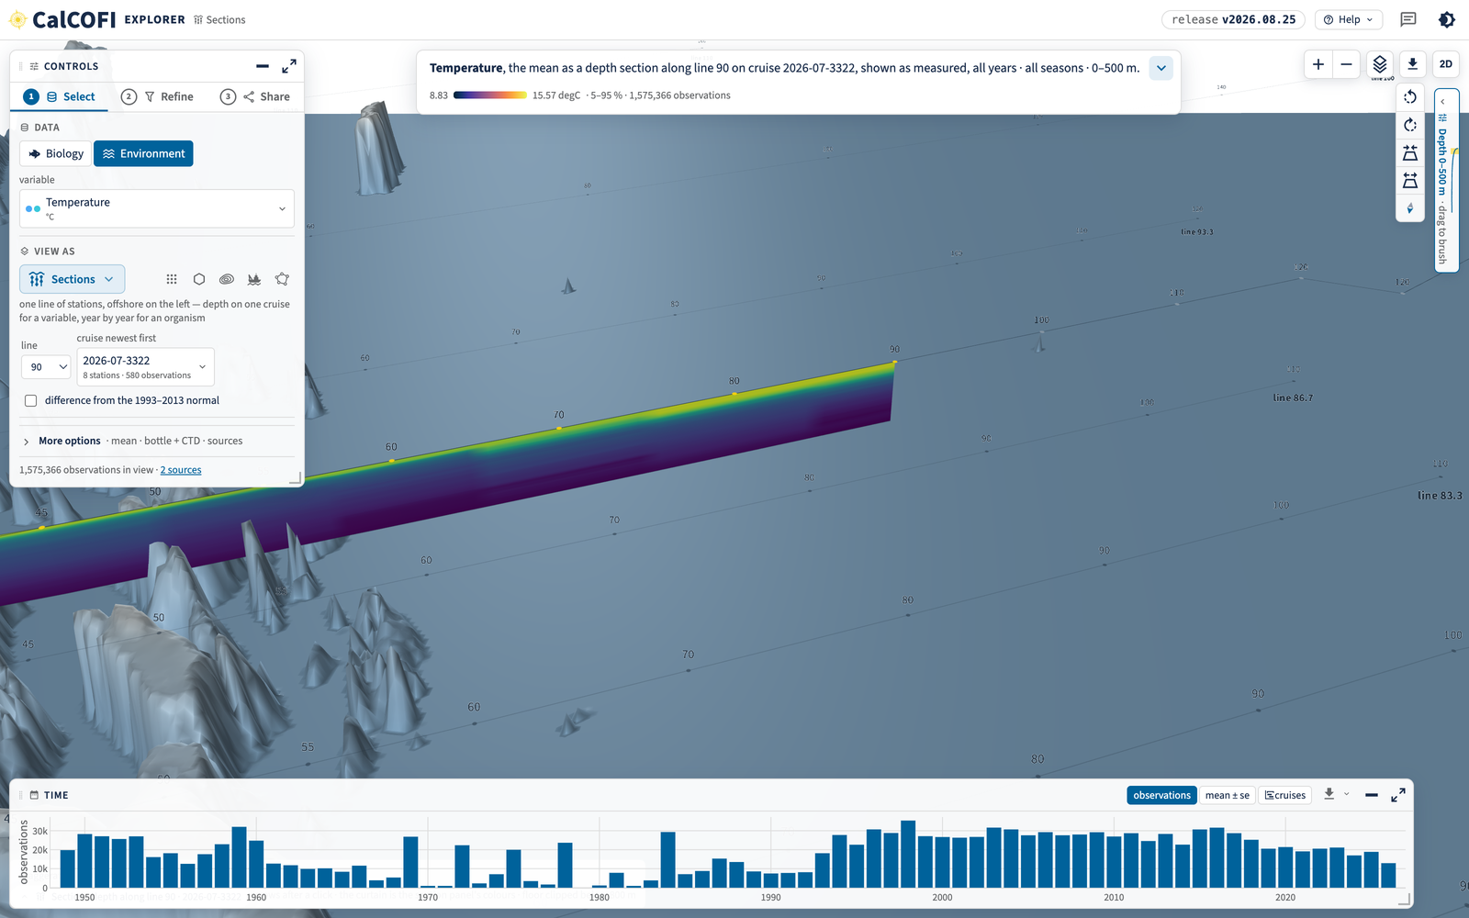
ALSO LANDED · THE EXPLORER
A COASTLINE, NAMES ON THE SEA FLOOR, A 3-D CAMERA
Land is an OpenStreetMap mask drawn over the sea floor and the data — the coast is crisp at every zoom.
Undersea feature names on from the start, and island names; both label families on a dial.
3-D sections: a camera column (rotate · tilt · compass), keys, vertical exaggeration, and cam= in the URL.
Sections key on the station; each variable’s colour ramp now reaches every lens.
Sections in 3-D, line 90, cruise 2026-07-3322 — a development shot of 9/10 (older lockup).
calcofi.io/explore · Sections in 3-D
CalCOFI.io update · 2026-09-23 · 26
Notes:
Explorer changes since 9/8, mostly from your reviews on 9/9 and 9/10. The coast is a land mask: CARTO's water sinks under the sea floor and the data, and OpenStreetMap's land polygons draw over them, so the data are clipped at the real coast (built as a PMTiles reference layer by ingest_spatial.qmd; land is always on and no longer a row of the Layers card). The GEBCO gazetteer's undersea feature names are on from the start, above the data and out of the legend; island names come from CARTO's tiles, which carry them from zoom 8; both label families were toned down, each with its own opacity dial, and basemap=nolabels gives a data-only figure. The 3-D section curtain gained a camera column (rotate, tilt, compass), keyboard control, vertical exaggeration as a Layers row, the station grid drawn at the surface, and cam= in the URL so a view can be shared. The Sections lens keys stations on site_key (PR #10) and, since WS-R6, every lens takes the variable's cmocean ramp from one rule. The shot is the development capture of 2026-09-10 (explore/shots/tour/sections_3d.png) and shows the older 'CalCOFI' lockup, since changed to 'CalCOFI.io'. Sources: explore commits 4446e06, 14e5452, 761d2bf, 1c3f417, 047d693, 0b0a5f9, 7df3456, 9873f0e, aee0e8a, 16a9083, 36f0022; plan 2026-09-09 'Explorer reference layers'.

Slide 27






ALSO LANDED
RELEASES, PUBLISHERS, SERVER, PACKAGES, TEAM
Releases
Publishers
Portals, watched
v2026.09.10 and v2026.09.11, each with a DOI. The obs parquet copy is being retired; obs stays a view.
Rebuild only what changed; publish_status says which portal is behind. EDI, OBIS and netCDF rebuilt on v2026.09.11.
A weekly observer records what each portal says (9/14, 9/21) and regenerates the sitemap.
Server
Packages
Team
ERDDAP refuses unconstrained dumps (the 9/8 outage); fail2ban on the host; CORS for browser clients.
calcofi4r 1.24.2 · calcofi4py 0.9.3 · calcofi4db 4.15.0; README examples are a release gate.
~75 old issues closed; one board, CalCOFI.io, with Betty’s issues; 16 metadata proposals reviewed.
RELEASES.html
CalCOFI.io update · 2026-09-23 · 27
Notes:
The rest, in one breath. Releases: v2026.09.10 (DOI 10.5281/zenodo.22698724: stations not cells, reference layers, measured keys, the taxa and measurements catalog records, publisher idempotence, dataset colours re-spread) and v2026.09.11 (DOI 10.5281/zenodo.22714951: CTD averages by the flag rule, bottle bounds, ammonium and METS categories, taxa.json 1.1); the deprecated obs parquet objects are being retired — v2026.09.10 announced it, seven readers were measured to break and are listed for fixing first, and obs stays the catalog view over obs_bio + obs_env. Publishers: a re-run over a frozen release is a hash comparison, only what changed is rebuilt, publish_status lists which portal is behind; on 9/12 EDI, OBIS and netCDF were rebuilt, ERDDAP redeployed and netCDF published on v2026.09.11. A weekly observer records what the portals say and regenerates the sitemap (9/14, 9/21). Server: ERDDAP refuses tabledap/griddap data requests with an empty query (the 9/8 outage), fail2ban is installed and version-controlled, and ERDDAP has CORS so DuckDB-WASM clients can read it (9/15). Packages: calcofi4r 1.24.2, calcofi4py 0.9.3, calcofi4db 4.15.0; the README examples of both client packages are now tests that gate a release. Team: about 75 old issues closed with a note on what superseded each, the old Management board closed, project board 5 'CalCOFI.io' with Betty's issues; the 16 dataset_meta proposals were reviewed against the record (#79), and ZooDB question Q05 answered (pooling regions are boundaries). Sources: RELEASES.md; workflows d0d2d83, ebe3f66, 4a3ce8f, 8f33e0b, 282ff48, d76c492, ff5ac10, c2b9ef6; server 0965ce1, ca368b0, 205a126; package NEWS.

Slide 28
DECISIONS AND ASKS
DECISIONS AND ASKS, WITH AN OWNER EACH
Ask | Proposed owner | Proposed answer
Sign-off of the “why” picks and quotations | Erin, Rasmus | a pass per category; Wikipedia stays an alternative, never the pick
Species photos and lead sentences | Erin, Betty | review the most observed taxa per class (30 done); one CSV row per override
Too much, too little, other ways in (slide 16) | everyone | pick two; one pull request each
Temperature ramp in sections | Rasmus | both apps read ramps.ts; he picks thermal or blue–red for values
The CTD’s first EDI package | Rasmus, Marina, Betty | final + with bottle, by decade, CC BY 4.0, via DataZoo
Archive vs calcofi.org CTD copies | Ben B. → Jim Wilkinson | calcofi.org stays the source until he confirms
Derived hydrographic products | Rasmus (equations) | a derived dataset beside the CTD casts
ctd-transects PR #4 | Ben B. | review and merge this week
github.com/orgs/CalCOFI/projects/5
CalCOFI.io update · 2026-09-23 · 28
Notes:
Eight lines, each with a proposed owner and a proposed answer on the table — the owners and answers are mine to propose and yours to change. 1 Quotations: a review pass on the 'why' picks by whoever owns each category, with Wikipedia kept as an alternative and never the pick. 2 Species photos and lead sentences: extend the 30-page hand review to the most observed taxa per class; an override is one row of rank_override.csv. 3 Scope: pick two of the options on slide 16; each becomes one pull request. 4 Ramp: both apps read the Explorer's ramps.ts; Rasmus chooses thermal or blue–red for temperature values. 5 The CTD's first EDI package, per the 9/16 meeting. 6 Archive vs calcofi.org copies: I write Jim Wilkinson, cc Rasmus, Kelsey and Ben G.; until he answers the ingest keeps preferring calcofi.org, which changes nothing for the 66 overlapping cruises. 7 Derived hydrographic products: once Rasmus sends the equations, a derived dataset beside the CTD casts so it can be downloaded and picked in the Explorer. 8 PR #4: I review and merge this week. Everything is on the GitHub board 'CalCOFI.io' (project 5).

Slide 29
NAME IT. PLACE IT.
TRUST IT.
Every organism and every measurement has a page; every station is itself; every CTD average follows the provider’s rule.
Next: the CTD to EDI, and one colour language across the apps. Tell us what to fold, drop or add.
Ben Best · Ocean Metrics · ben@oceanmetrics.io · data@calcofi.io
Notes:
Said once, evenly: name it, place it, trust it. Every organism and every measurement has a page; every station is itself; every CTD average follows the provider's rule. Next is the CTD to EDI and one colour language across the apps — and your calls on slides 14 and 15 decide what the pages fold, drop or add. Then stop and listen.

Slide 30

APPENDIX
EVERY LINK SHOWN
Page | Link
Front door | calcofi.io
Data · one search | calcofi.io/#datasets
Species catalog | calcofi.io/species
Pacific sardine | calcofi.io/species/worms-217452
Measurements | calcofi.io/measurements
Temperature | calcofi.io/measurements/temperature
Nitrate | calcofi.io/measurements/nitrate
CTD cast dataset | calcofi.io/datasets/calcofi_ctd-cast
Explorer | calcofi.io/explore
Page | Link
ctd-transects | calcofi.io/ctd-transects
PR #4 | github.com/CalCOFI/ctd-transects/pull/4
Ramps | github.com/CalCOFI/explore/blob/main/src/ramps.ts
Release notes | storage.calcofi.io/calcofi-db/ducklake/releases/RELEASES.html
DOI v2026.09.11 | doi.org/10.5281/zenodo.22714951
DOI v2026.09.10 | doi.org/10.5281/zenodo.22698724
The database | calcofi.io/docs/db.html
Board | github.com/orgs/CalCOFI/projects/5
Contact | data@calcofi.io
calcofi.io
CalCOFI.io update · 2026-09-23 · 30
Notes:
Every link shown in the deck, clickable, for the PDF. The calcofi.io pages were shot from a local build of CalCOFI.github.io main (1e1ffe0, 2026-09-16) on release v2026.09.11; the live site builds from the same commit. RELEASES.html anchors each version heading (#v2026.09.11, #v2026.09.10).

